Slide 1
Bed Bugs
Baillie Guichon, SN-AD2; Brad Kartchner, SN-AD2; and Tess Richardson, SN3
University of Lethbridge
Instructor: Marci Neher-Schwengler, BN, RN
Notes:
The information in this presentation is outlined in detail in the accompanying educational manual. References for the materials herein, including images, can be found in the same manual.
It is anticipated that the presenter will have read through the manual prior to giving this presentation for an overall understanding of the content. However, brief notes are included throughout the presentation to cover main points.

Slide 2
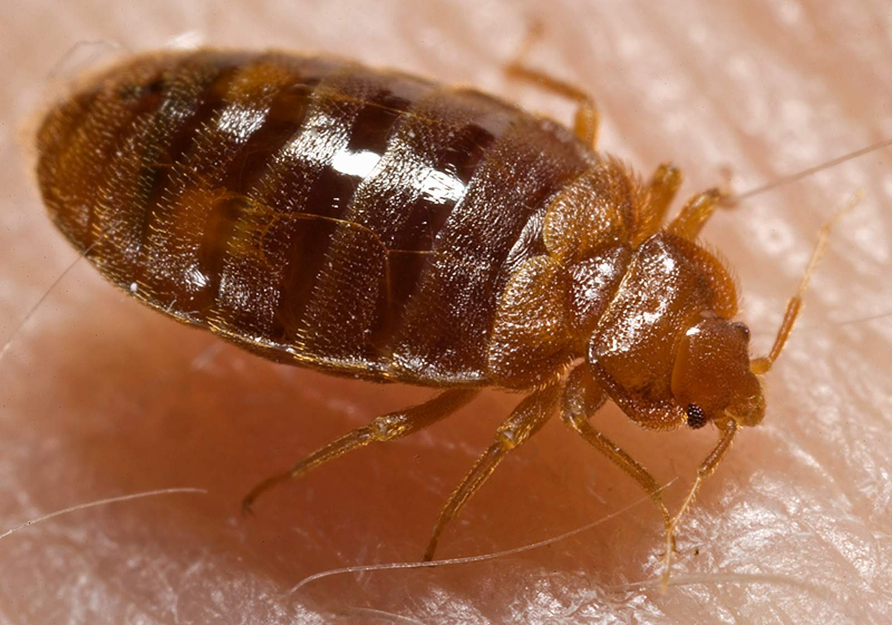
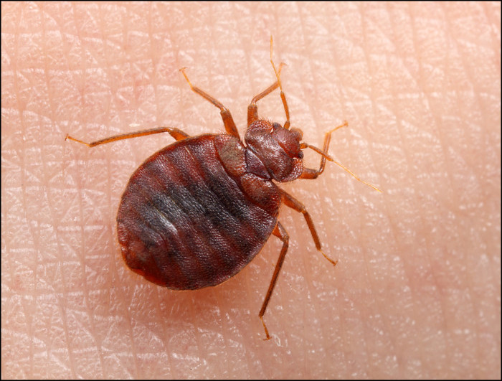
Bed Bugs
Notes:
Flat and wingless
Reddish-brown in colour, deeper red after a feed

Slide 3
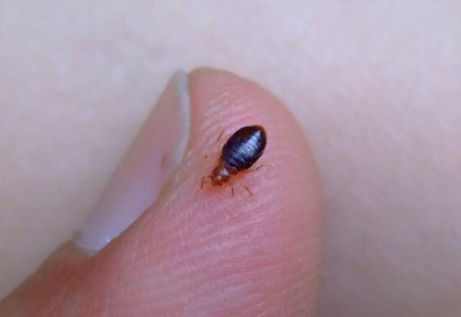
Size
Notes:
Approximately the size of an apple seed or a grain of rice
Adult bed bugs can be seen by the naked eye
Using a magnifying glass and flashlight can help to identify bed bugs
Bed bug eggs are very difficult to see with the naked eye

Slide 4
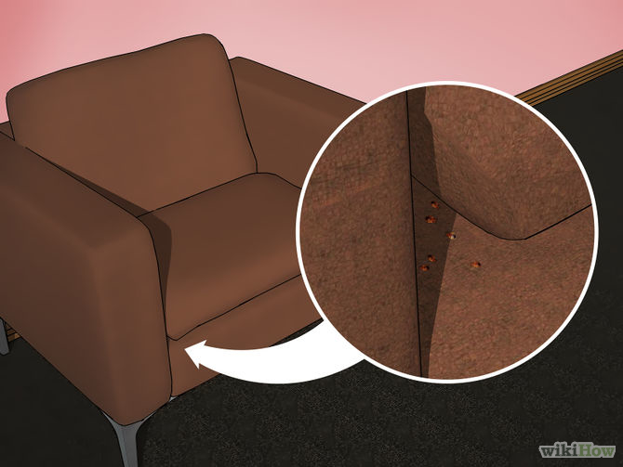
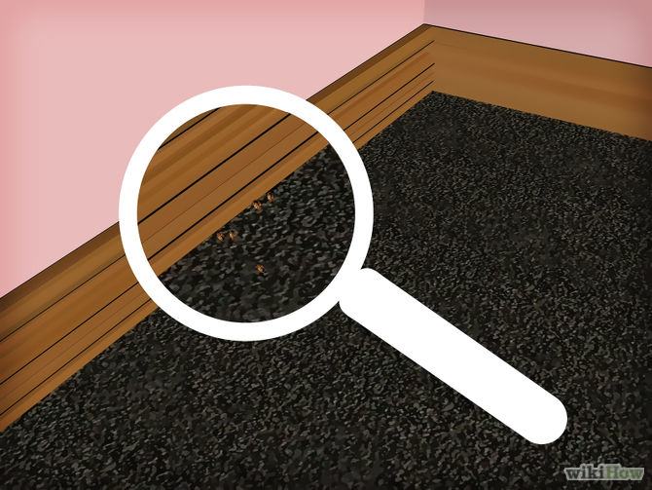
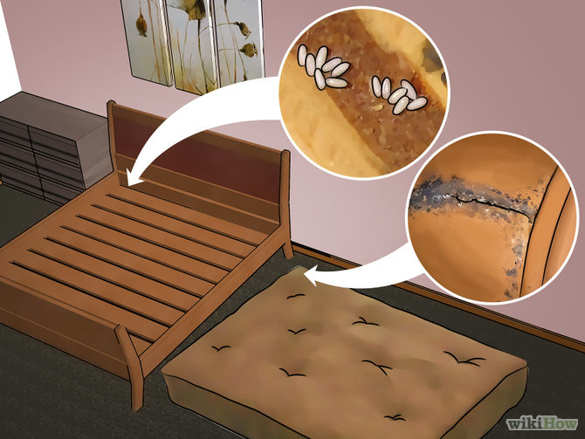
Where Are They Found?
Notes:
Bed bugs are commonly found on/in:
Beds
Sofas
Chairs
Areas where people sleep or lounge
Dresser Drawers
Baseboards
Cracks in plaster or wallpaper
In extreme infestations they may also be found in heating ducts and behind electrical plates

Slide 5
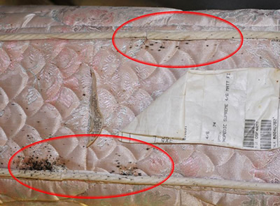
What to Look For
Notes:
Streaks of feces on seams of mattresses, bedding, and clothing; may also see streaks in dresser drawers or on wooden bed frames
Appear dark red or brown in color, but look like blood when dabbed with a damp tissue

Slide 6
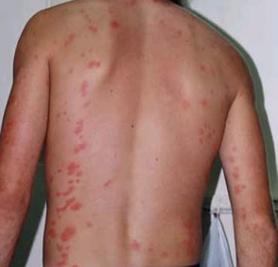
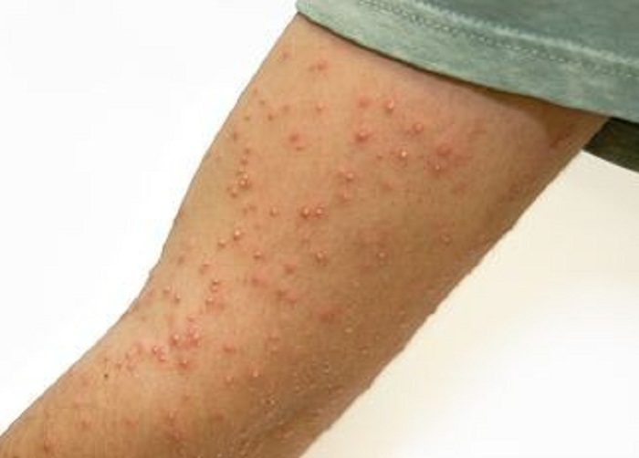
Bed Bug Bites
Notes:
Bites are usually red, but may form white welts; they are generally inflamed and itchy
Bites tend to appear in rows, rather than randomly (see picture on left)
Known as “breakfast, lunch, and dinner”
Severity of bites varies from person to person depending on the reaction of each individual’s immune system
Elderly clients usually react less severely than other age groups
Bites generally appear on exposed areas of skin when sleeping (arms, legs, and shoulders)
Bed bugs do not carry diseases, but their bites can become itchy, red, and in severe cases infection
Signs of severe reaction and infection from bites are; pain, severe swelling and redness, discharge or pus, and warmth to affected area

Slide 7
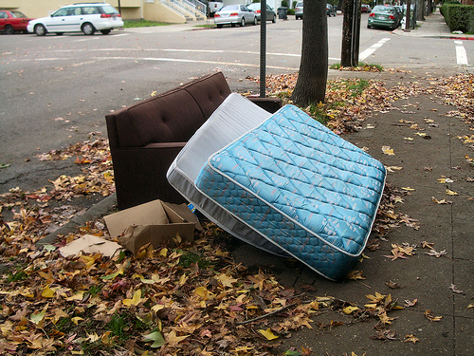
How Did I Get Bed Bugs?
Notes:
Bed bugs can come from a variety of sources, but two of the most likely scenarios are from second hand furniture (especially items bought from sources other than second hand stores), and from visiting locations that already have bed bugs.
All it takes is to sit on an infested surface (bed, couch, chair, etc.) or put an item such as a coat or purse on those surfaces to acquire some hitchhiking bed bugs.

Slide 8
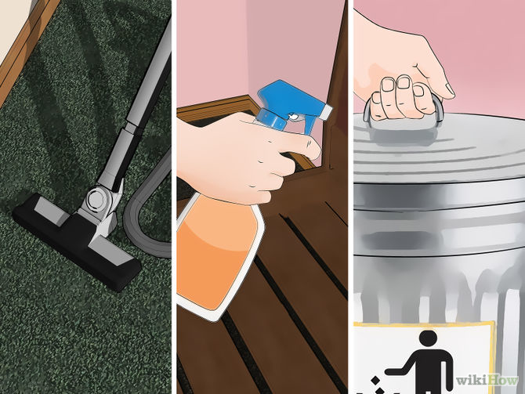
What Do I Do? Clean!
Notes:
The best and first line of defence for homeowners and tenants is to declutter and clean daily.

Slide 9
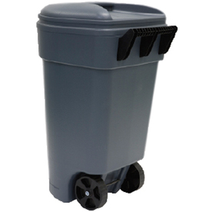
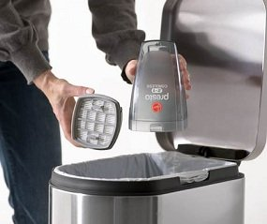
Vacuum
Notes:
Mattresses, box springs, bed frames, couches, and chairs should be vacuumed daily during an infestation
Vacuum floors, dresser drawers, couches, and chairs regularly or as needed
Be sure to empty vacuum bag into a plastic bag and immediately take to a garbage outside. Do not leave vacuum bags in vacuum or garbages in the house.

Slide 10
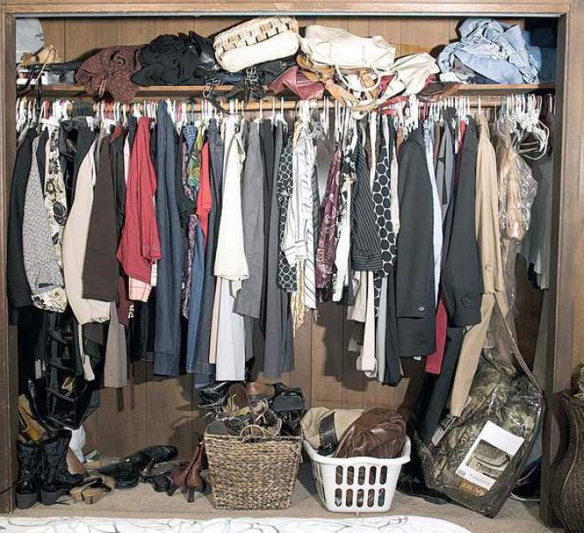
Declutter
Notes:
Keep a tidy house - reduce or eliminate clutter
This can be done by:
thinning closets
keeping clothes and bedding folded and put away (instead of on the floor)
Keep coats, bags, and footwear in entryway and hallway closets, rather than in bedroom closets or on the floor
vacuum these closets out at least once a week during an infestation

Slide 11
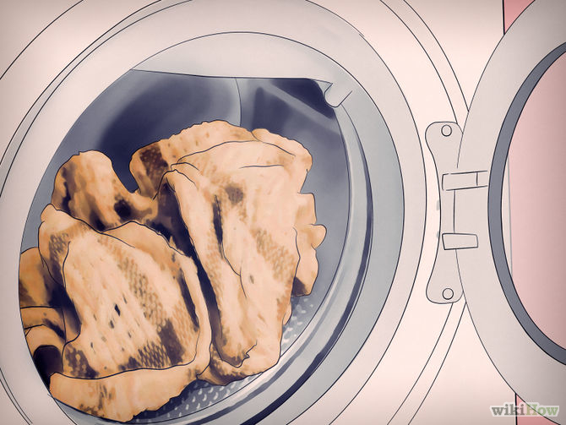
Wash and Dry
Wash
Hot Water
75 Minutes
Dry
High Heat
90-120 Minutes
Notes:
Clothing worn the previous day and during the night, as well as bedding, should be laundered daily using the directions below and on the next slide:
LAUNDRY DIRECTIONS:
Wash in hot water (>50℃) for a minimum of 75 minutes.
Dry items at the highest allowable heat for between 90 - 120 minutes.
After drying, immediately place items into sealed plastic bags

Slide 12
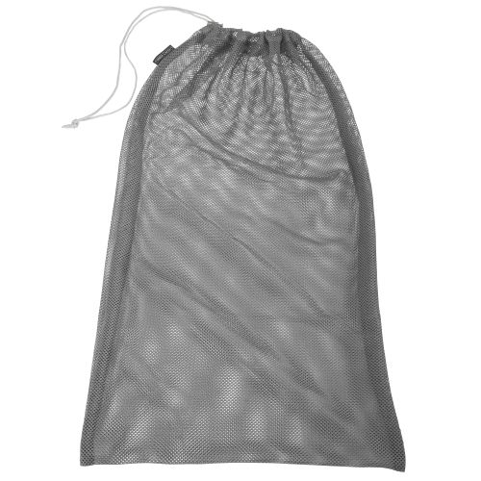
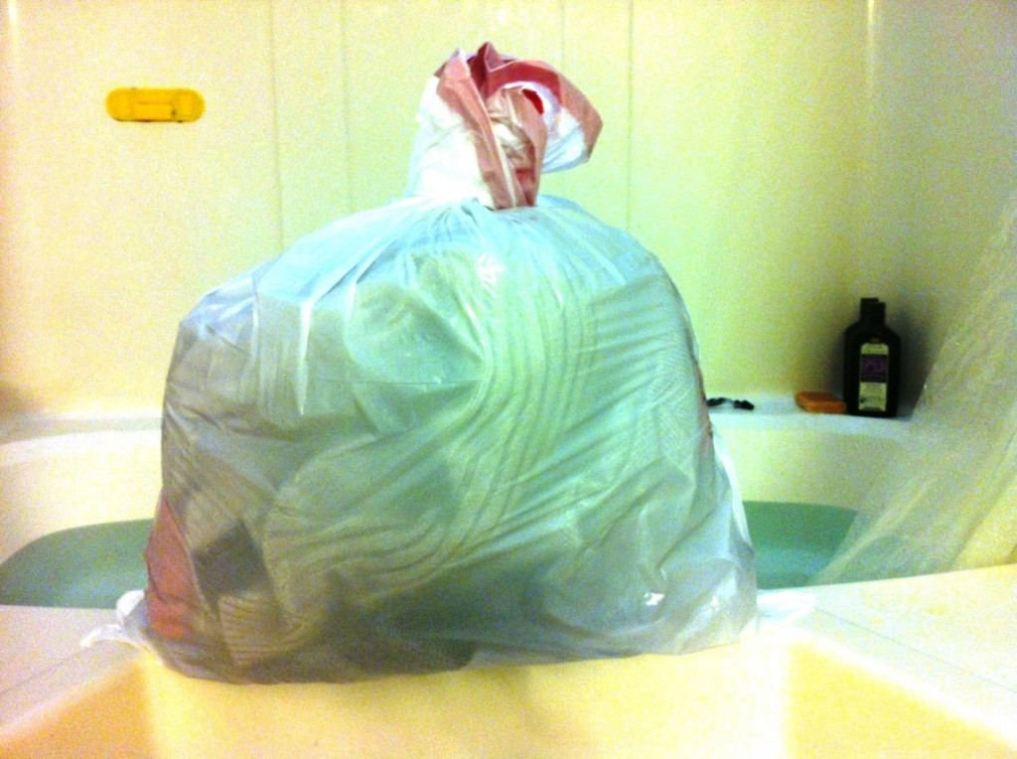
Delicate Items
Notes:
For delicate items, such as saris, lower heat (but the highest allowable) for longer periods may be effective.
Delicate items can also be placed in mesh bags or pillow cases to minimize stretch and snagging.
If these items must be taken to a dry cleaner, they should be sealed in plastic bags and the dry cleaner should be called in advance and notified that the items being brought in have bed bugs.
A potential alternative is placing items in sealed plastic bags and leaving them in the freezer for a few days, after which they can be taken outside and shaken out.

Slide 13
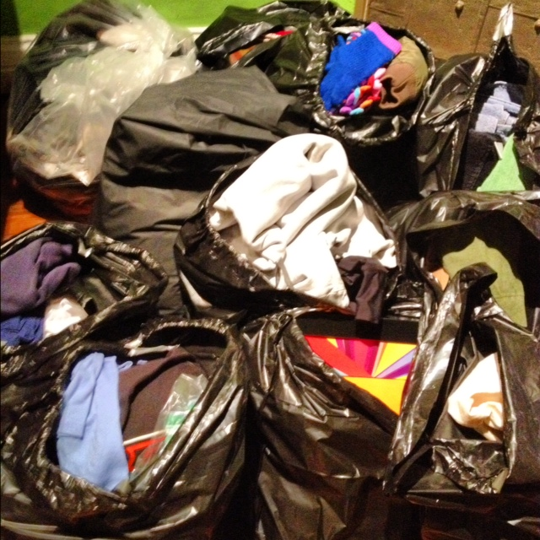
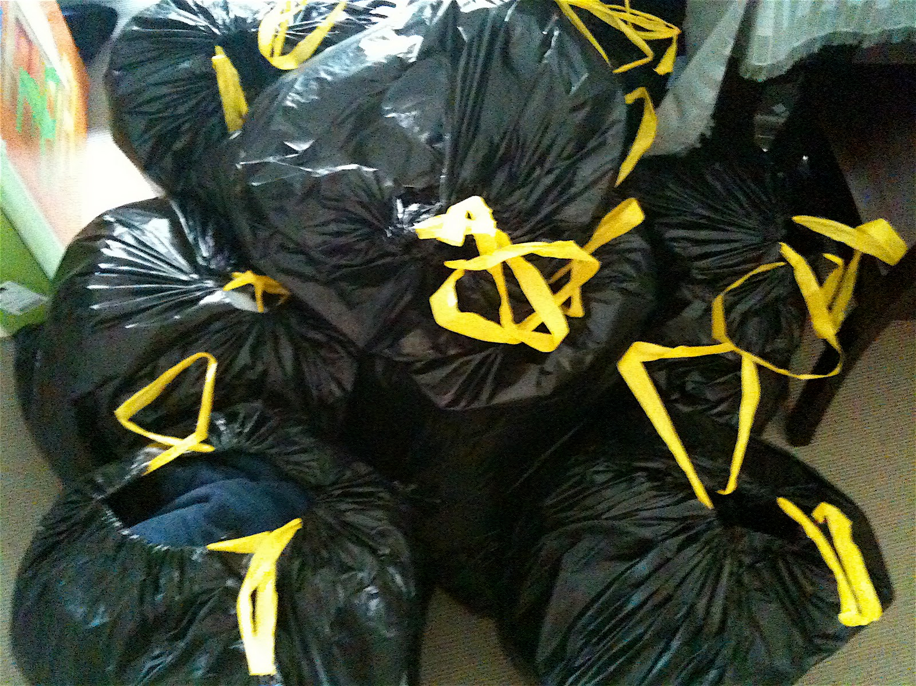
Seal Clothes in Plastic Bags
Notes:
Freshly laundered clothing should be immediately sealed in plastic bags and kept off the bed, couch, and floors to prevent reinfestation.
Sealed bags should not be opened until after showering to prevent bugs from infested clothing falling into the bags

Slide 14
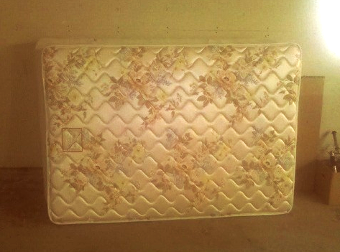
Mattress Daytime Storage
Notes:
During an infestation, the bedding should be removed and laundered daily
Mattresses and box springs should be vacuumed daily
The mattress should be taken off the box spring, and propped against the wall during the day
Bed bugs prefer to spend the time when they are not feeding in wooden box springs where it is darker and quieter
Before replacing the mattress, vacuum the box spring and mattress again

Slide 15
Stop The Spread
1
2
3
5
4
Notes:
The easiest way to spread bed bugs and slow the process of eradication is by visiting homes that have them, or receiving visitors who have an infestation.
If temporarily halting visitation is not an option, showering in conjunction with laundering directions should be followed immediately prior to visiting or receiving visitors

Slide 16
It’s Hard Work!
Notes:
Getting rid of bed bugs is hard work, and it’s a process! With time, elbow grease, and plenty of patience, the battle can be won. Don’t get frustrated, give it time, and keep at it!

