Slide 1
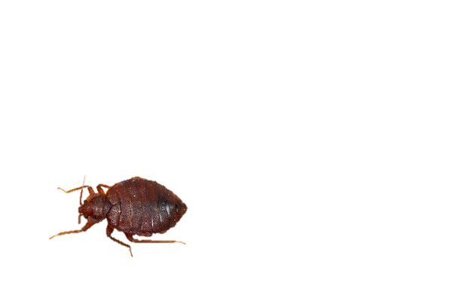
BED BUGS!
A PROBLEM WE CAN SOLVE…
TOGETHER!

Slide 2

BED BUGS!
WHAT are BED BUGS?
WHERE are they?
HOW do I know?
HOW they SPREAD
CONSEQUENCES
WHAT TO DO?!?!

Slide 3
WHY ME?!
Bed bugs can happen to ANYONE
  Does not matter who you are, what you do, where you are from or how CLEAN your house is
  They can travel on people and things you take with you, but they like to live near where you sleep
NOT SHAMEFUL and WE ALL MUST WORK TOGETHER

Slide 4
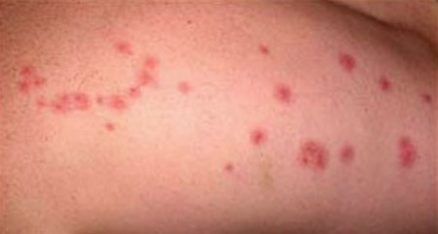
WHAT ARE BED BUGS?
BUGS that feed on human’s blood but do NOT live on people
When bite they inject an anesthetic so you don’t feel pain when they bite
Most people will get itchy red bumps but some do not react to the bite
  (might not know that they have a bed bug problem!)

Slide 5

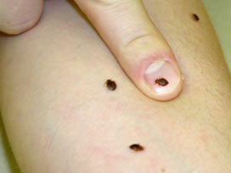
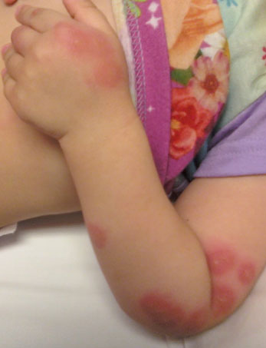
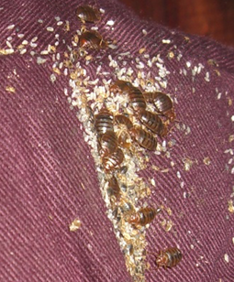
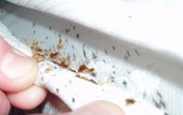
WHAT TO LOOK FOR:
BUGS [DON’T SQUISH! FLUSH!]
BITES
BLOOD (BED BUG POOP!)

Slide 6
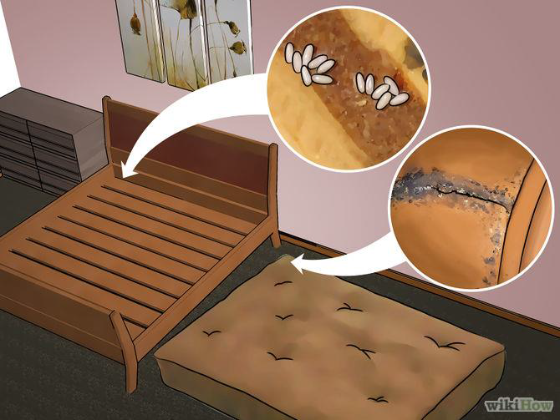
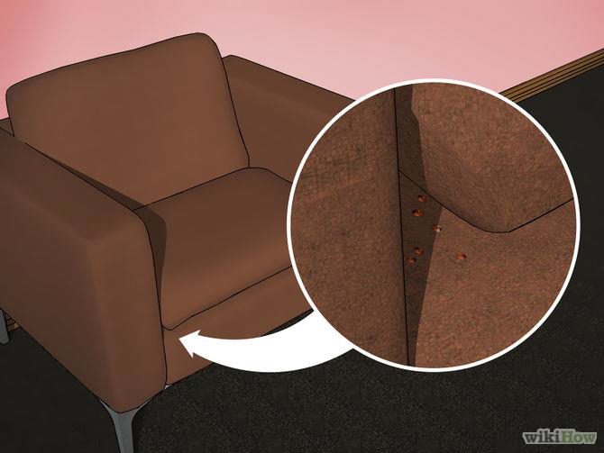
WHERE?!
BED BUGS want to stay near YOU
They LIVE near beds, couches and comfy chairs (where people sleep or sit for a long time)
They can HIDE in VERY SMALL CRACKS

Slide 7
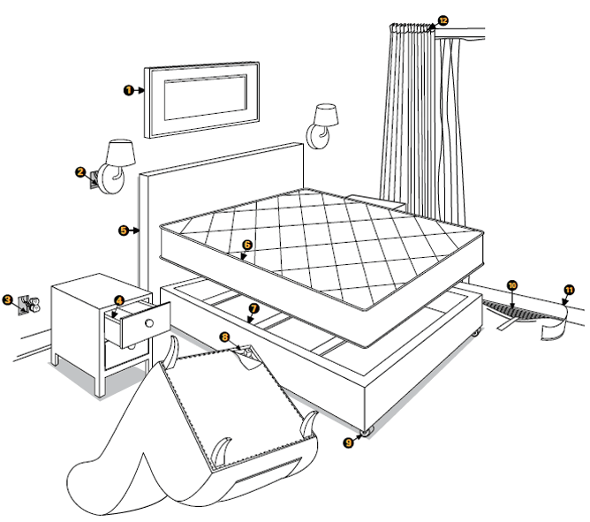
WHERE TO LOOK

Slide 8

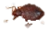
HOW DO THEY SPREAD?
BED BUGS can get in clothes, bags and shoes and move with PEOPLE
They are SMALL and REALLY GOOD AT HIDING

Slide 9
CONSEQUENCES
HEALTH
  Bed bugs do not carry diseases
  Bites can become infected when scratched
  Anxiety and poor sleep
LANDLORD
  If a tenant does not follow landlord’s instructions there could be consequences including paying for treatment and eviction
SERVICES
  Some important in-home services could stop if bed bugs are not treated (like homecare, Parents as Teacher, etc)

Slide 10
SERIOUS PROBLEM!
In CANADA, BED BUGS are considered a SERIOUS PROBLEM
It is NOT acceptable to live with BED BUGS and not act to fix the problem
LANDLORDS may EVICT tenants who do NOT act to destroy bed bugs or do not PROTECT themselves
  And you can be DENIED RENTING your next house!

Slide 11
WHAT TO DO?!
THIS is a COMMUNITY PROBLEM that cannot be SOLVED unless PEOPLE WORK TOGETHER
IGNORING the PROBLEM, and PRETENDING that it is not happening will make it WORSE
  Ask yourself:
    DO I WANT TO GIVE BED BUGS TO MY FRIENDS OR FAMILY, WHO THEN ALSO HAVE TO SUFFER BITES AND POSSIBLY BE CHARGED LOTS OF MONEY?
TALK ABOUT BED BUGS!

Slide 12


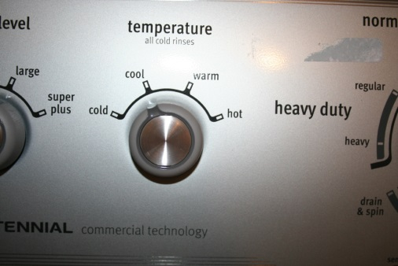

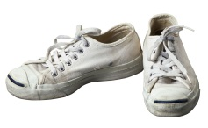
ACTION!
VACUUM, VACUUM! VACUUM!!!
LAUNDRY!
TIDY!
1.5 hours
TALK.

Slide 13

VISITING
IF YOU HAVE BED BUGS OR IF YOU DON’T WANT THEM!
BRUSH OFF BEFORE ENTERING
SIT ON WOOD OR PLASTIC CHAIR (NOT SOFT CHAIR)
DO NOT PUT PURSE/BAG ON CARPET OR COUCH
DO NOT SLEEP OVER
VACUUM AFTER GUESTS HAVE LEFT
CLEAN BEDDING (if they slept over)
PUT CLOTHES IN DRYER IMMEDIATELY WHEN YOU GET HOME FROM VISITING
PUT ON CLOTHES THAT HAVE BEEN IN THE DRYER FOR 1.5 HOURS (OR DRIED AND SEALED IN BAGS)
IMMEDIATELY LEAVE YOUR HOUSE (DO NOT SIT DOWN)

Slide 14
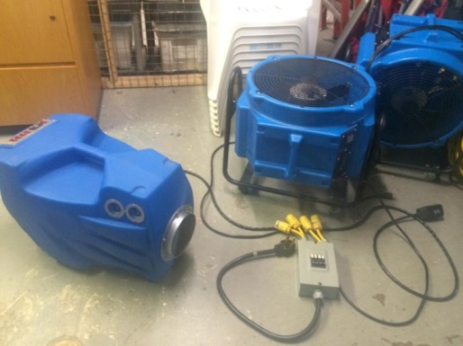
TREATMENT OPTIONS
FUMIGATION (CHEMICAL SPRAYING):
  Professionals spray chemicals (2x) to kill bed bugs
  Arranged by landlord or tenant/home-owner
  Cost = $300 - $600
HEAT TREATMENT
  Uses heat to kill bed bugs and eggs
  LFS-IS has rented 3 machines
  Cost = higher utility bill and extensive preparation

