Slide 1
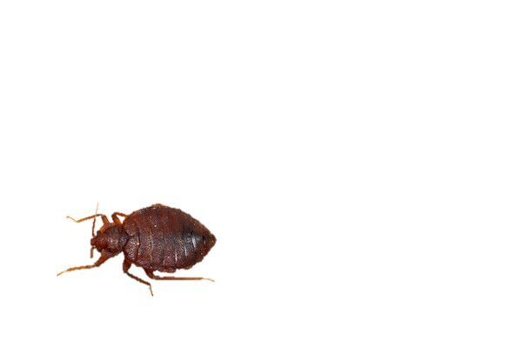
BED BUGS!
PREPARATION for
FUMIGATION

Slide 2
TODAY:
BED BUG BASICS
FUMIGATION / “SPRAYING”
RESPONSIBILITIES
PLAN
PREPARATION
AFTER-TREATMENT
PREVENTING SPREAD

Slide 3
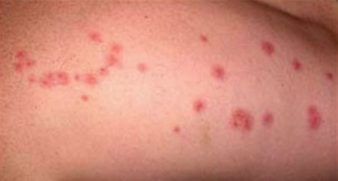
BED BUGS?
BUGS that feed on human’s blood but do NOT live on people
When THEY BITE they inject an anesthetic so you don’t feel pain when they bite
Most people will get itchy red bumps but some do not react to the bite
  (might not know that they have a bed bug problem!)

Slide 4
TREATMENT
TREATING BED BUGS IS NOT OPTIONAL
BED BUGS in LETHBRIDGE is a GROWING PROBLEM
NOT ONLY a BHUTANESE/NEPALI PROBLEM – but there are reasons why that community is more vulnerable to getting/spreading bed bugs
NO ONE WANTS the BHUTANESE/NEPALI COMMUNITY to get a NEGATIVE REPUTATION within LETHBRIDGE

Slide 5
FUMIGATION / “SPRAYING”:
Your LANDLORD or YOU arranges to have a professional come to your HOME and SPRAY CHEMICALS that will KILL the BED BUGS
CHEMICALS are SAFE BUT CANNOT TOUCH HUMAN SKIN
  MUST STAY AWAY for 6-8 HOURS while it DRIES
  DOES NOT SPRAY MATTRESS or COUCH CUSHIONS
COST = between $400 - $1200
FUMIGATORS are HELPERS
  BUT YOU and YOUR FAMILY are RESPONSIBLE (for getting rid of the bugs and preventing them from returning)

Slide 6
RESPONSIBILITIES:
LANDLORD:
  ARRANGE for TREATMENT
FUMIGATORS
  SPRAY CHEMICALS TWICE to KILL the BED BUGS
TENANT:
  REPORT to LANDLORD
  PREPARE for TREATMENT
  COMMUNICATE (with landlord & fumigator) and BE HOME at assigned day and time
  FOLLOW INSTRUCTIONS (this orientation & fumigator’s instructions)
  PREVENT BUGS from RETURNING
  KEEP CHECKING!

Slide 7
PLAN:
INFORM LANDLORD of BED BUGS
BUY BOX-SPRING COVER(S)
LANDLORD or FUMIGATOR will NOTIFY you of DAY of TREATMENT (BE HOME!!!!)
FOLLOW PREPARATION INSTRUCTIONS
LEAVE HOME FOR 6-8 HOURS DURING TREATMENT (FOR YOUR HEALTH!)
RETURN HOME (but don’t return everything to where it was before – they will be spraying again in 7-10 days)

Slide 8


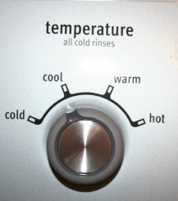
PREPARATION: BEDDING
PILLOWS
CAN GO INTO THE DRYER INSTEAD OF WASHER
TIE IN BAG
TIGHTLY!
ALL BEDDING
(pillows, sheets, blankets, mattress covers, bed skirts – everything!)
DRY
HOT!
90 MINUTES
WASH
HOT!
TIE IN DIFFERENT BAG
- PLACE IN MIDDLE OF ROOM
- DO NOT TOUCH UNTIL TREATMENT FINISHED

Slide 9
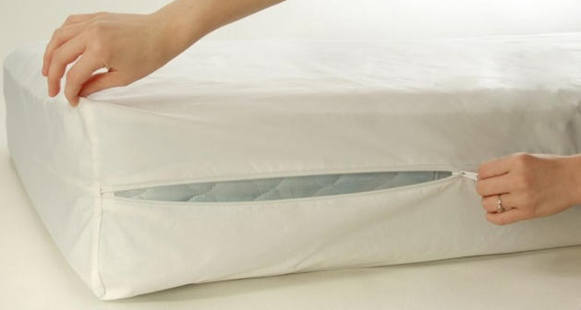
PREPARATION: BED
BUY a MATTRESS/BOX SPRING BED BUG cover
  Sears or Walmart
  (between $30 - $60~ depending on bed size!)
  (If you can only afford to buy one – the box-spring is most important)
  Zip up mattress/box-spring – BE CAREFUL NOT to RIP IT! (if it rips it is useless and cannot be returned!)
  if the legs of your bed attach directly to the box spring – remove them and lay the box-spring directly on the floor
  DO NOT OPEN FOR 2 YEARS!
    Any bed bugs living in your box-spring will die inside the cover without any chemicals – only time and lack of food

Slide 10
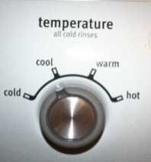
PREPARATIONS: CLOTHING
TIE IN BAG
TIGHTLY!
WASH
HOT!
ALL CLOTHES
(pants, shirts, pajamas, underwear, saris, scarfs, hats - everything!)
DELICATE CLOTH
Put into a pillowcase and put into the dryer without drying
SEALED IN BAGS
(until treatment is finished!)
SEPARATE 1 DAY of CLOTHES FOR WHOLE FAMILY to WEAR for DAY OF TREATMENT
DRY
HOT!
90 MINUTES

Slide 11





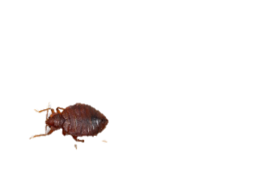

PREPARATIONS: ROOMS
BED BUGS
CAN LIVE ANYWHERE
BUT A TIDY AND CLEAN HOUSE GIVES THEM FEWER PLACES TO HIDE!
REMOVE ALL ITEMS from TABLES and SHELVES and FLOOR
LOOK VERY CLOSELY
For bugs or bug poop
CLEAN with RUBBING ALCOHOL
MOVE FURNITURE
1 foot away from walls
VACUUM
and IMMEDIATELY EMPTY and put in GARBAGE OUTSIDE
DO NOT MOVE THINGS TO NEW ROOM
OR NEW HOUSE
PUT ALL BAGS in MIDDLE OF ROOM

Slide 12

DAY OF TREATMENT:
DOUBLE-CHECK that you have FINISHED your PREPARATIONS
TAKE ONLY the CLOTHES and THINGS
you NEED
USE these PAPERS we give YOU to HELP CHECK
THE CHEMICAL that they will SPRAY is SAFE ONLY WHEN DRY – SO YOU MUST STAY AWAY FROM HOME WHILE IT IS DRYING
LEAVE your HOUSE and STAY AWAY for a MINIMUM OF 6 HOURS

Slide 13


AFTER-TREATMENT
THEY WILL SPRAY AGAIN IN 10 – 15 DAYS
BE VERY VERY VERY CAREFUL ABOUT NOT LETTING BED BUGS BACK INTO YOUR HOME
WHEN YOU RETURN to YOUR HOUSE you can RETURN your THINGS
BUT
ONLY WHAT YOU NEED
10 DAYS
$
SPRAYING COSTS MONEY –
IF YOU ARE NOT CAREFUL
(if you don’t follow instructions!)
YOU CAN BE CHARGED FOR THE NEXT TREATMENT!
IF YOU SEE BUGS AGAIN –
TELL LFS or YOUR LANDLORD!
(DON’T JUST “LIVE WITH IT”)
WATCH FOR BUGS, BUG POOP OR BITES!

Slide 14
PREVENTING SPREAD
IMPORTANT to help ensure that you do NOT get BED BUGS AGAIN, and so that your FRIENDS and FAMILY don’t get them either!
BED BUGS travel on PEOPLE’S CLOTHES and BAGS
CHECK your BAGS OFTEN and PUT YOUR BACK PACK INTO YOUR DRYER
VACUUM! VACUUM! VACUUM!!!
IF YOU SEE ANY BUGS – DON’T SMOOSH (FLUSH!)

Slide 15
VISITING
BE HONEST – visiting family and friends is important but you don’t want the bugs to visit too!
If you BELIEVE that you must VISIT:
  WEAR CLOTHES OUT of the DRYER or SEALED BAG
  IMMEDIATELY LEAVE HOUSE
  AT YOUR FRIEND’S HOUSE – LEAVE YOUR PURSE/BAG NEAR the DOOR or on HARD SURFACE (not a couch or bed)
  SIT ON A HARD CHAIR
  DON’T SLEEP OVER
  AT HOME – PUT YOUR CLOTHES DIRECTLY into the DRYER for 1.5 hours
IF PEOPLE VISIT YOU – VACUUM WHERE THEY SAT IMMEDIATELY AFTER THEY LEAVE

