Slide 1
Canadian Bhutanese Society
Annual Report 2014

Slide 2
CBS Executive Board Members 2014
President: Mr. Hemlal Timsina
Vice President: Miss. Geeta Rasaily
Secretary: Mr. Dhanan jaya Bhujel
Treasurer: Miss. Indira Sharma
Cultural Coordinater: Miss. Renuka Timsina
Cultural Special Events Coordinator: Mr. Kamal Dahal
Sport and Youth Coordinator: Mr. Chandra Adhakari

Slide 3
CBS Executive Board
हामी तपाइँको निरन्तर सहयोग को लागि सबैलाई धन्यवाद दिन चाहन्छु।
Notes:
Insert board photo

Slide 4
CBS Annual Report January 2014-December 2014
Welcoming the New Comers
Meetings
Training and workshop
Events
Achievements
Financial report
On going and future activities
Condolence

Slide 5
WELCOMING THE NEW COMERS
This year we have many new faces in Lethbridge. Some are stepping to this world for the first time and some have chosen this place as their future home. Many of us came from Nepal, and some of us moved from various provinces within Canada. Let us welcome them all together with a big applause.
2014 New Arrivals to Lethbridge: 110
Total Population:955

Slide 6
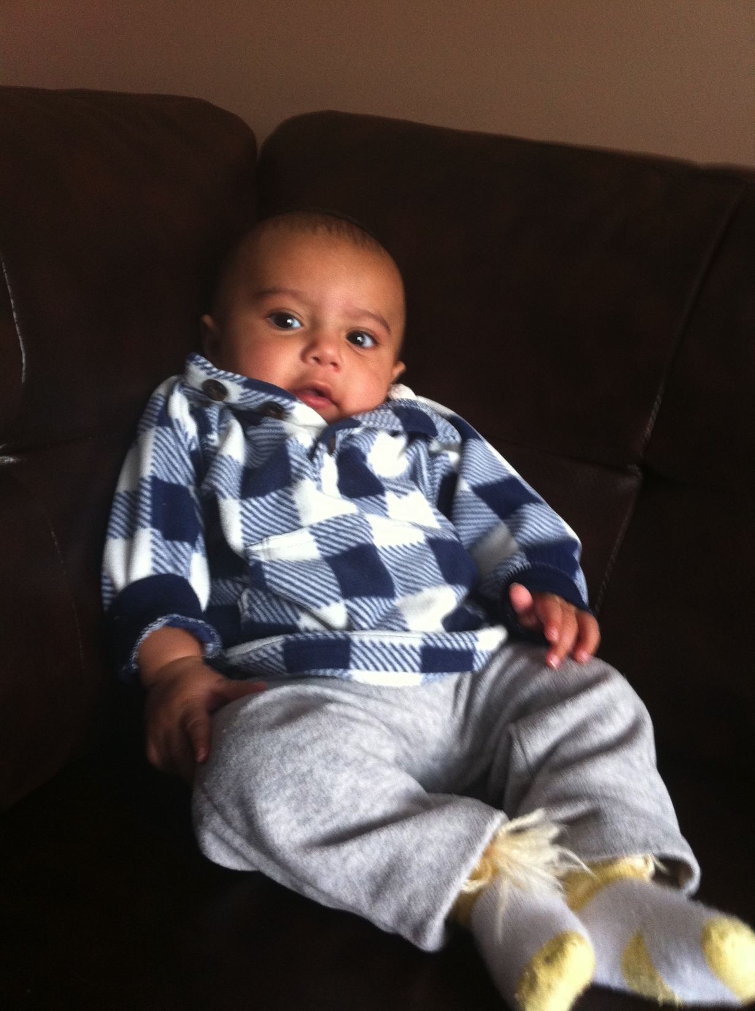
NEW BORN BABIES OF THIS YEAR “Future of our Society”
Bryan Rizal,June 30 2014

Slide 7
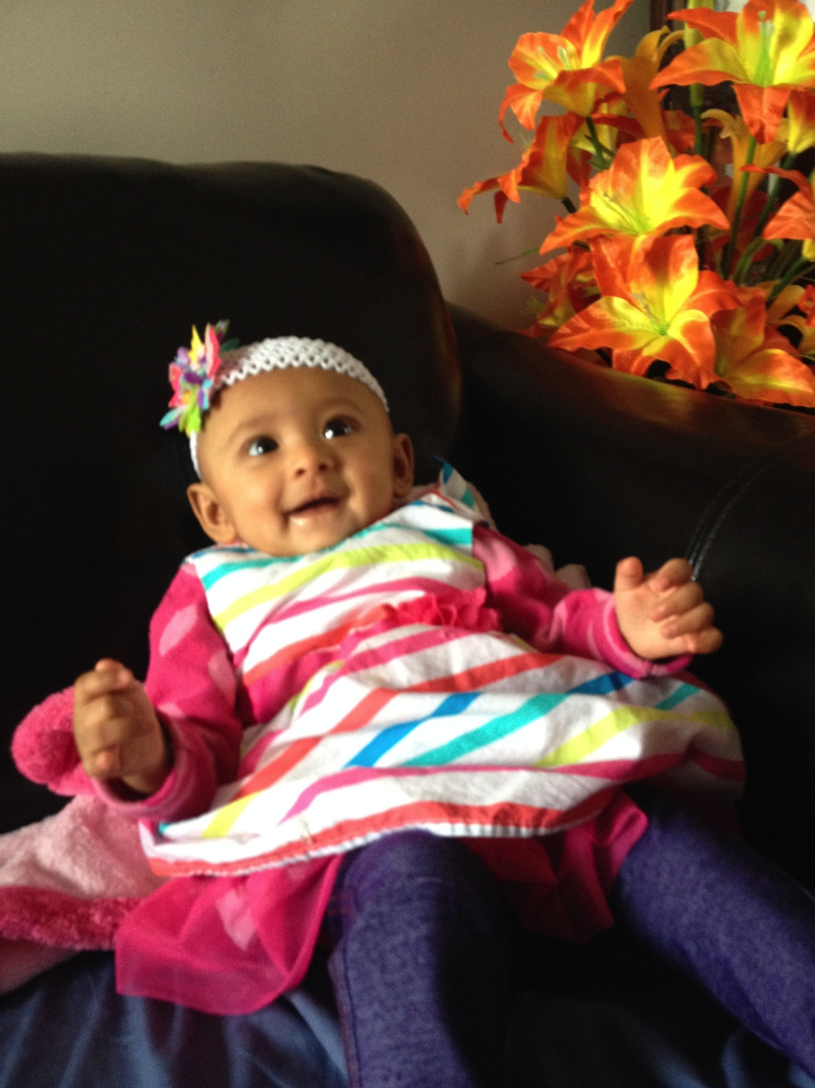
Angelina Kuikel June 18 2014
Notes:
Citizen ship 30

Slide 8
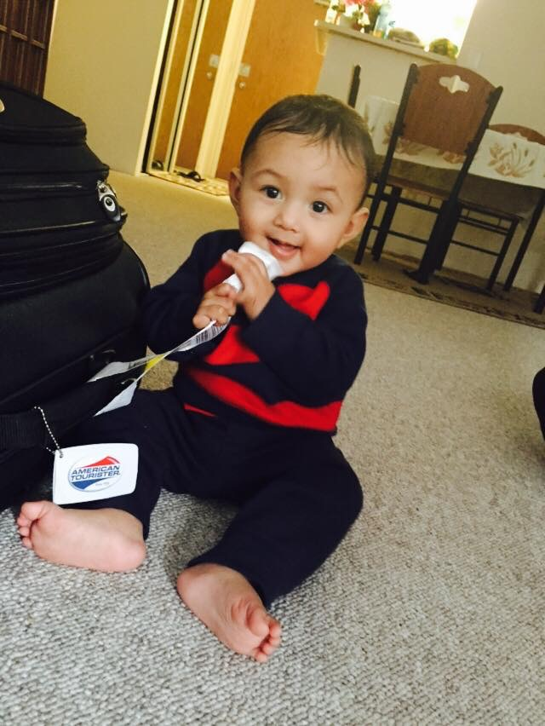
Nirav Subedi January 27th 2014
Notes:
Citizen ship 30

Slide 9
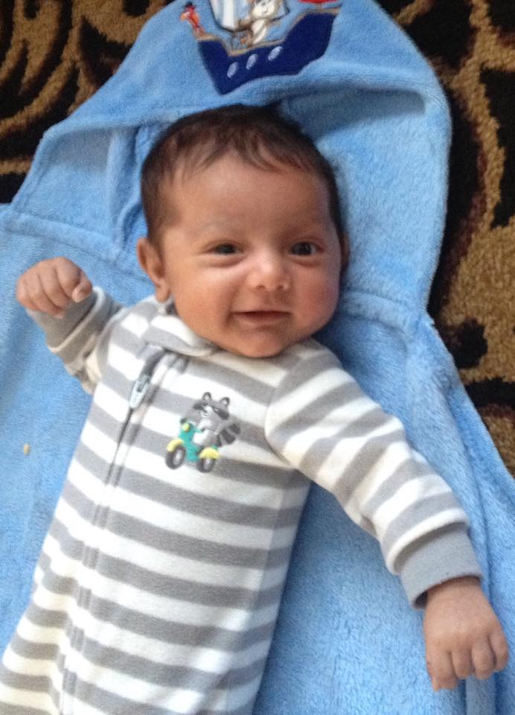
Prateek Timsina October 24th 2014
Notes:
Citizen ship 30

Slide 10
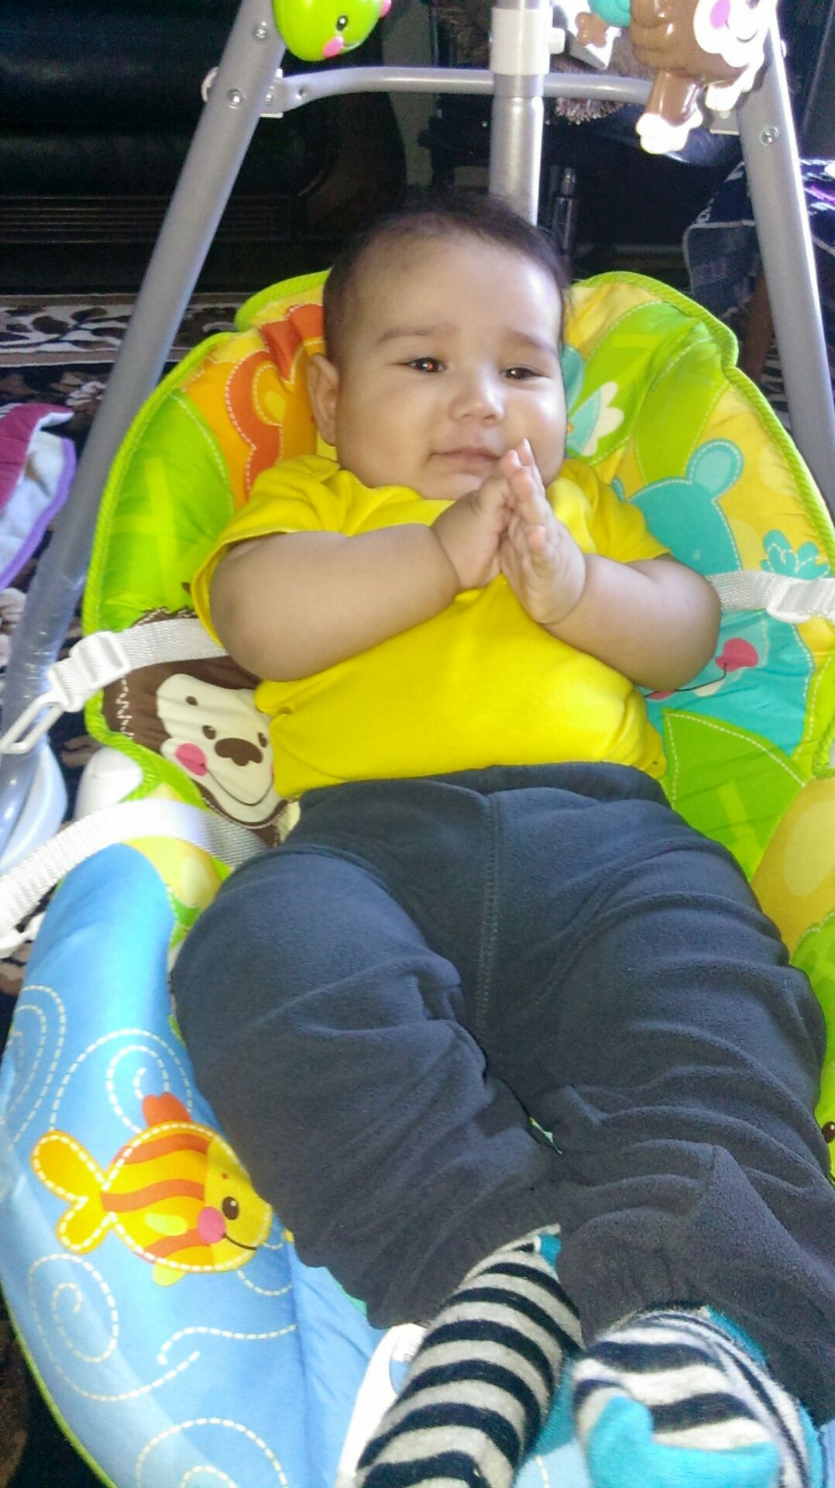
Tyson Kafley May 27th 2014.

Slide 11
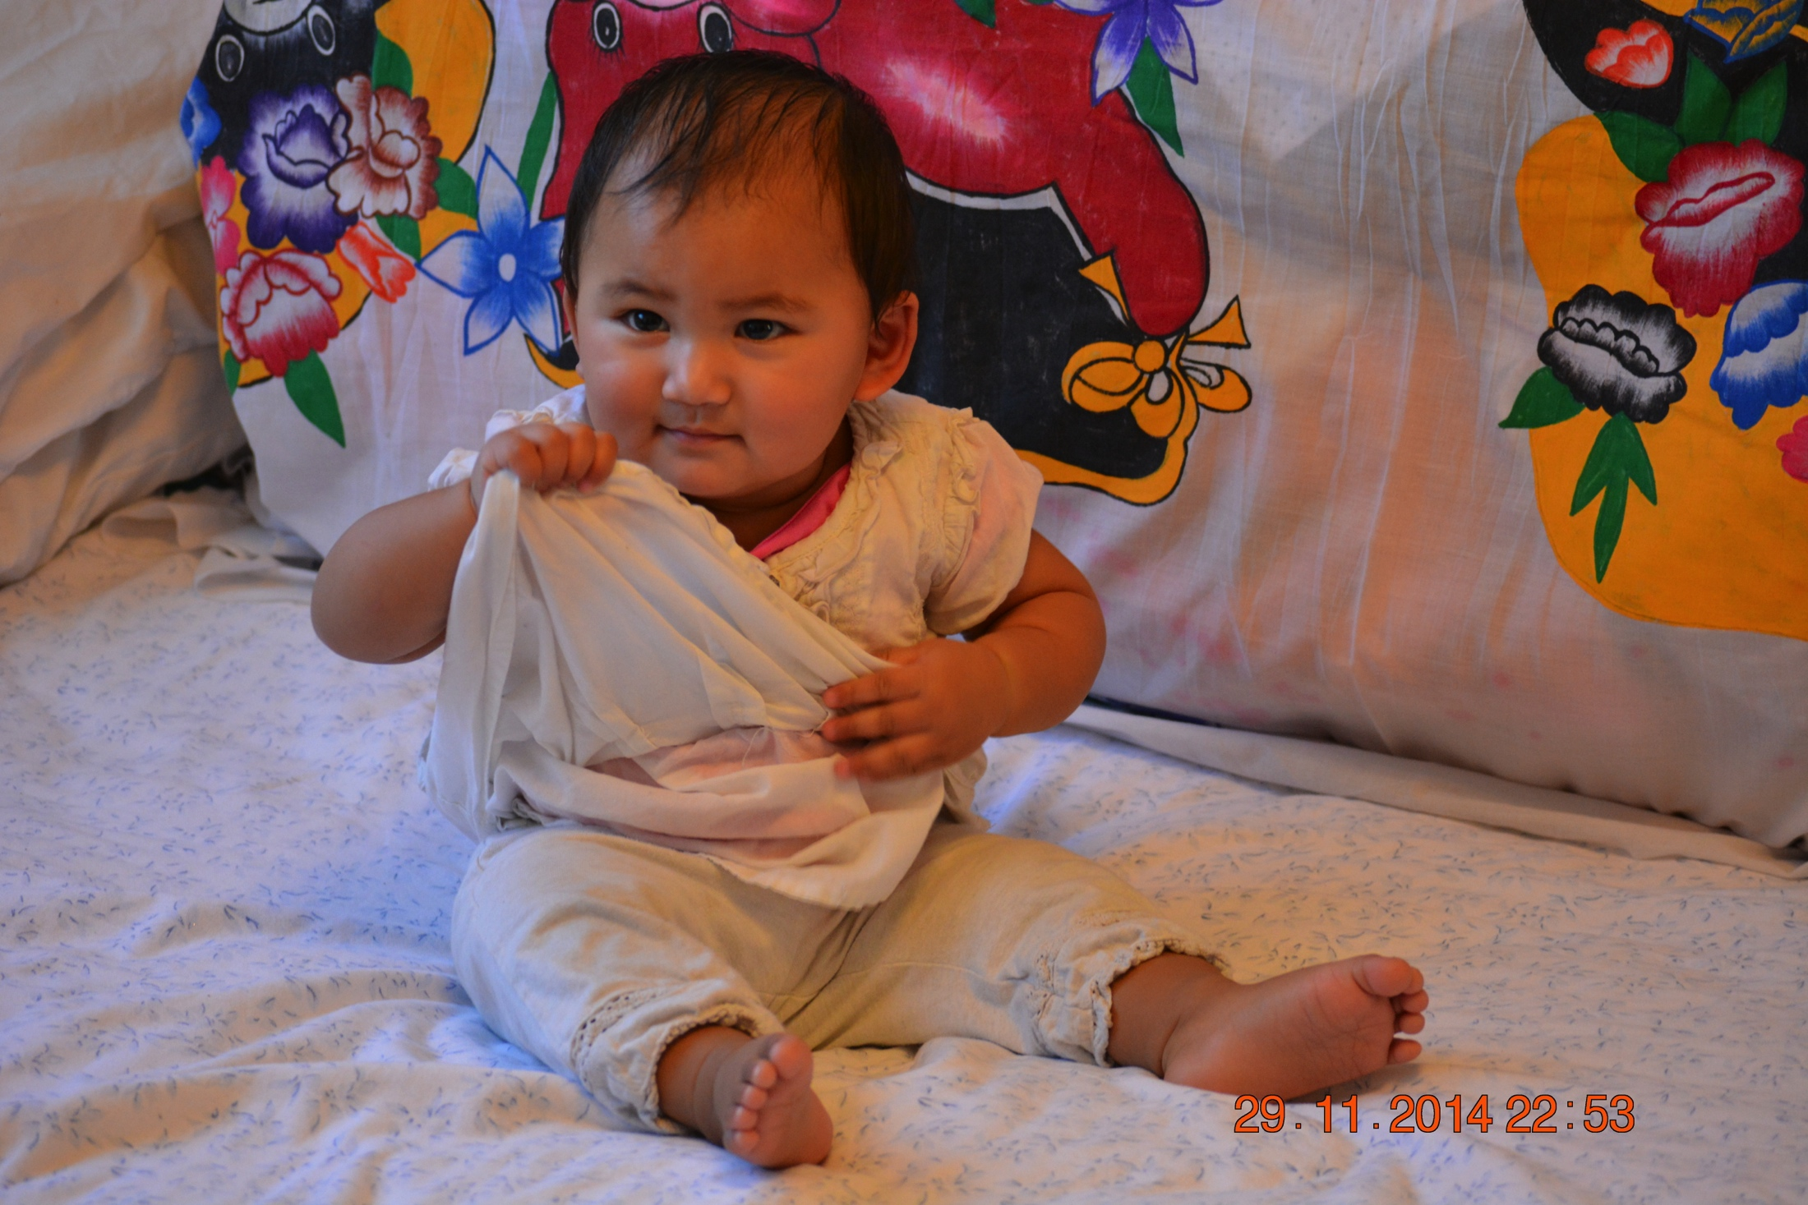
Prakriti Gurung
Notes:
Citizen ship 30

Slide 12
Kishan Rai’ child
Shristi Rai April 2nd’ 2014
Jasmine Rai June 14’ 2014
Prince Kafley October 31 2014
Notes:
Citizen ship 30

Slide 13
Meetings:
8 CBS Internal Meetings
3 Inter-Agency Meetings with LFS IS, SAEA
3 General Meetings
1 Seniors Meetings while on Nepali New Year Celebration
6 Meetings with Alberta Culture

Slide 14
Training and Workshop:
Three members of the CBS attended one day training organized by Alberta Liquor and Gaming Commission during the month of October 2014. Training was focus on how to avail, manage and maintain its responsibility of Casino funding.

Slide 15
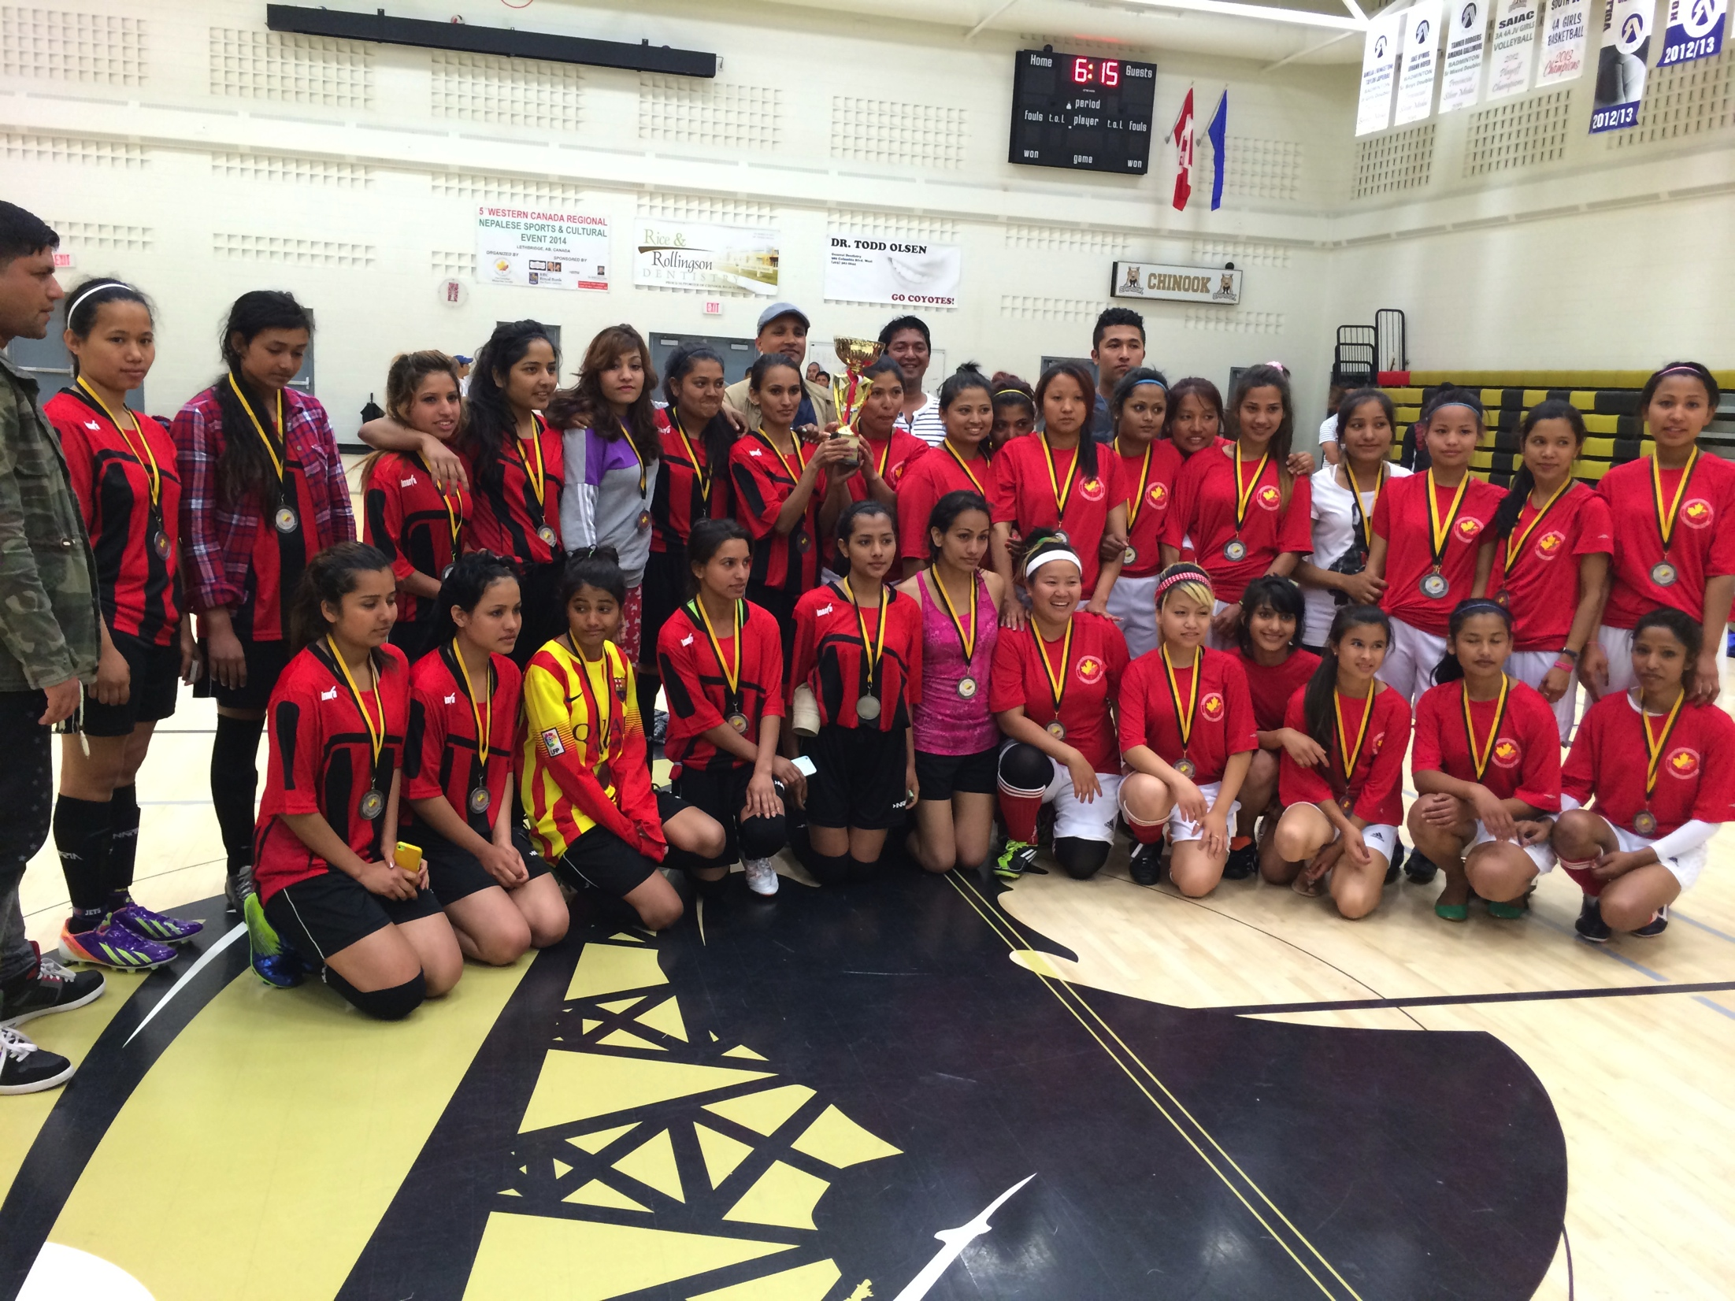
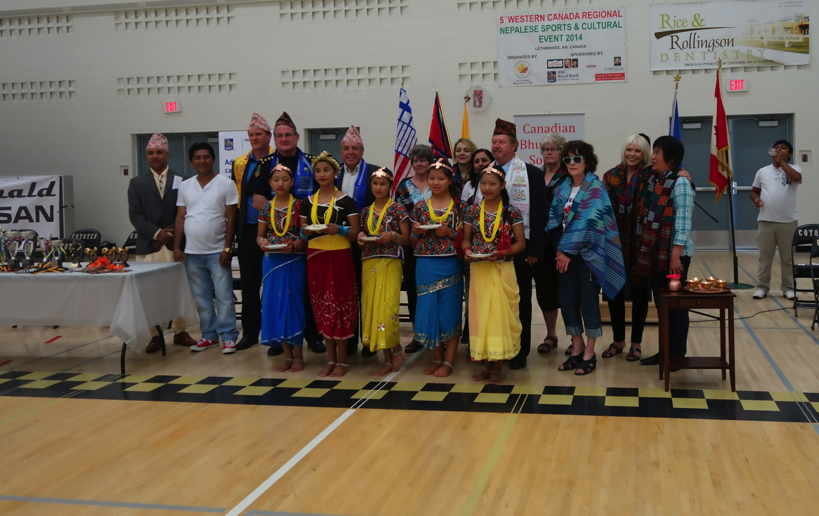
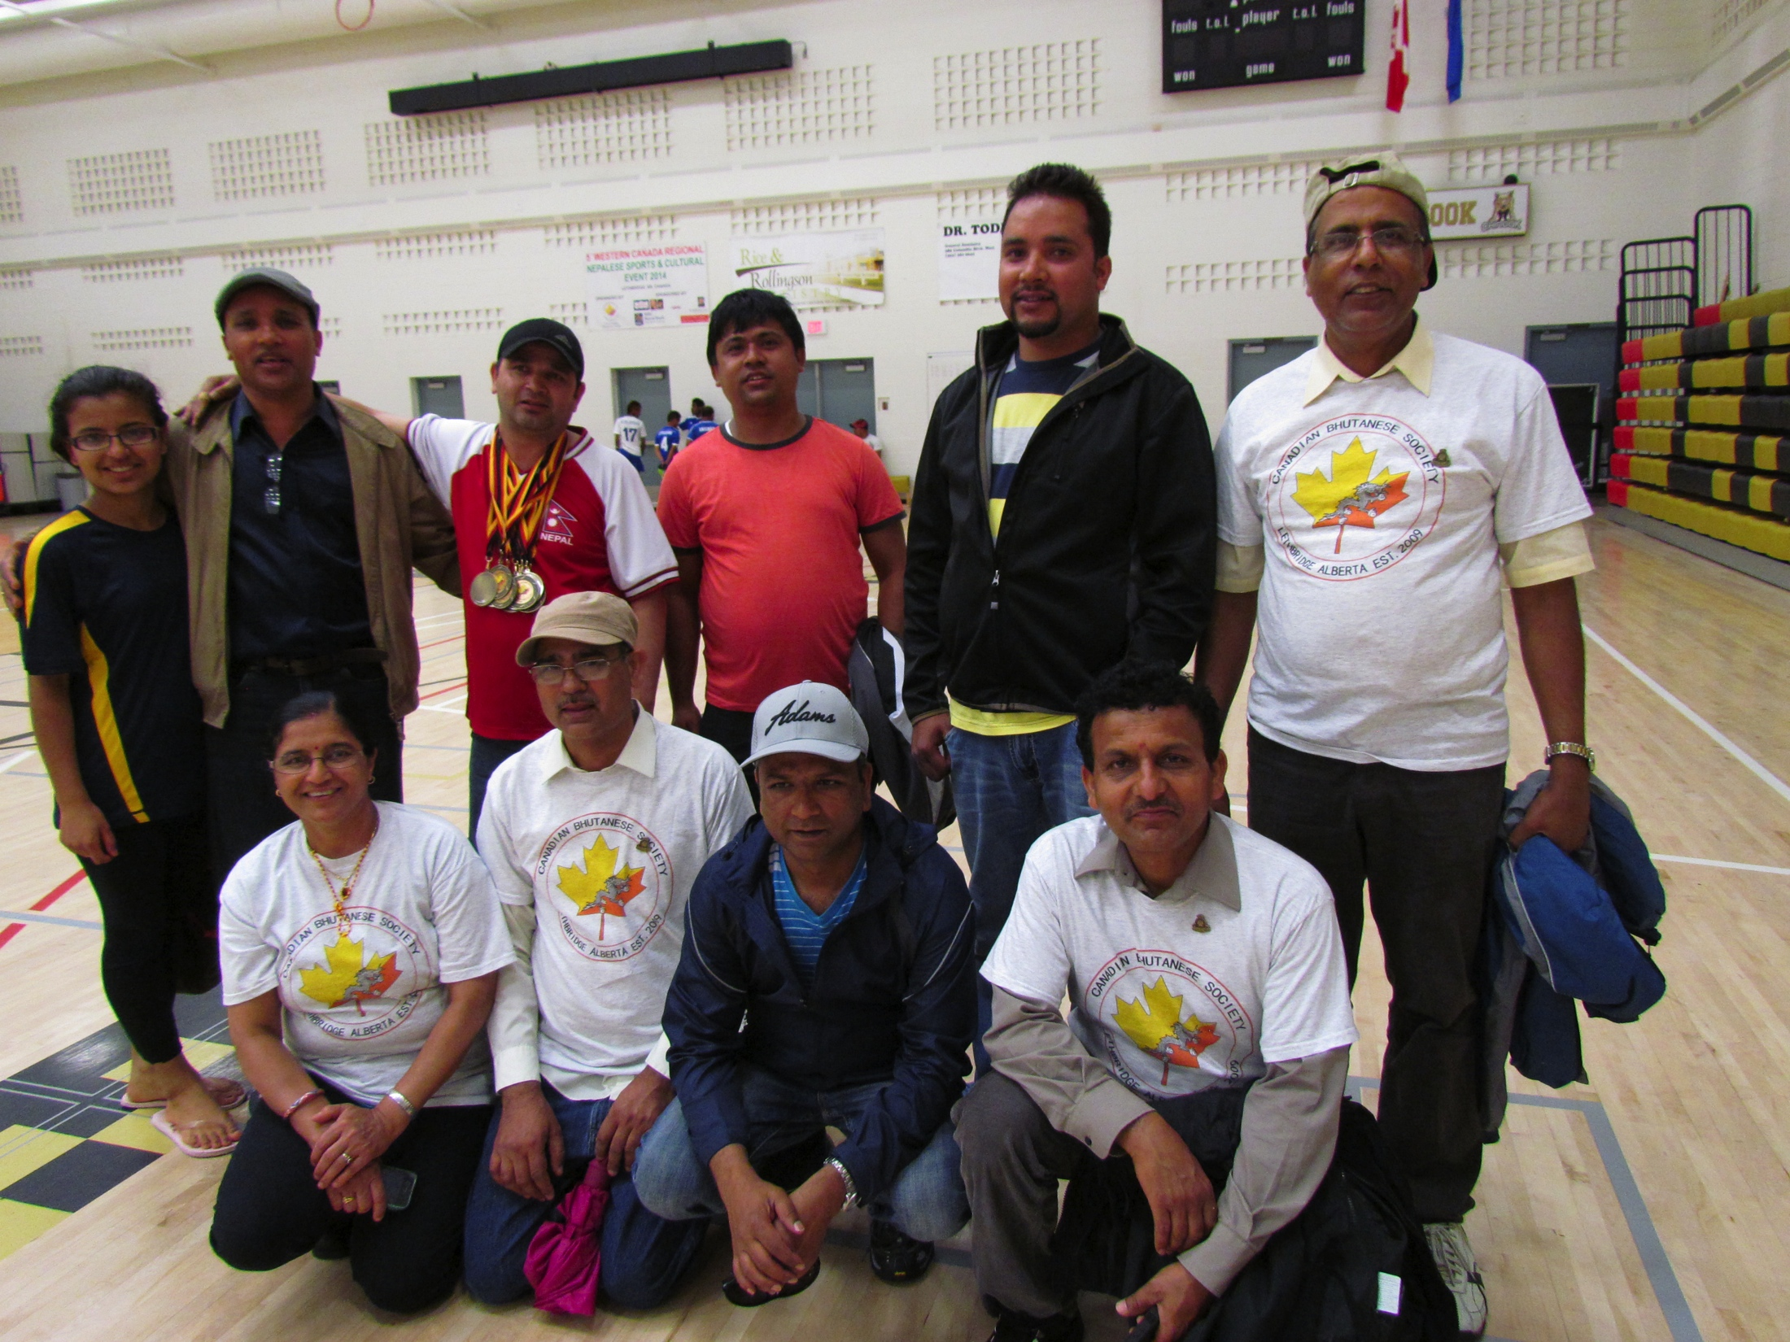
Events:
June 28, 29 : 5th Western Canada Regional Nepalese Sport & Cultural Event 2014
Notes:
Insert photo

Slide 16
Events:
May 1o, 2014: Dhiraj Rai & Sunita Dulal With local Artist, Concert

Slide 17
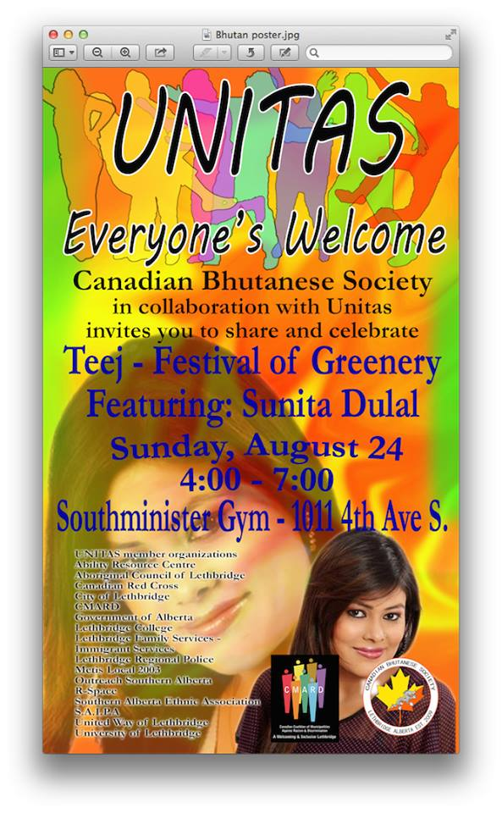
Events:
August 24,2014: Teej Special, Sunita Dulal Musical Night

Slide 18
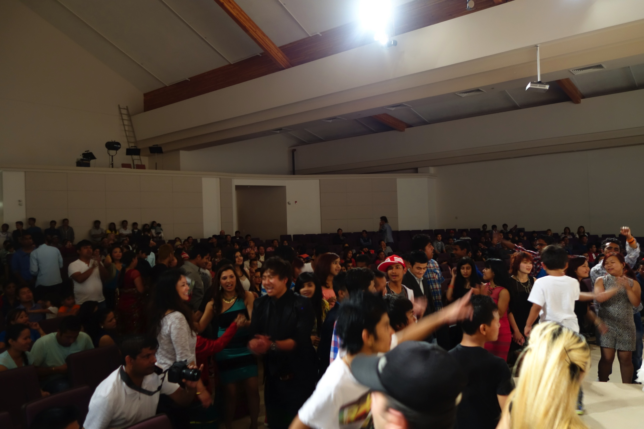
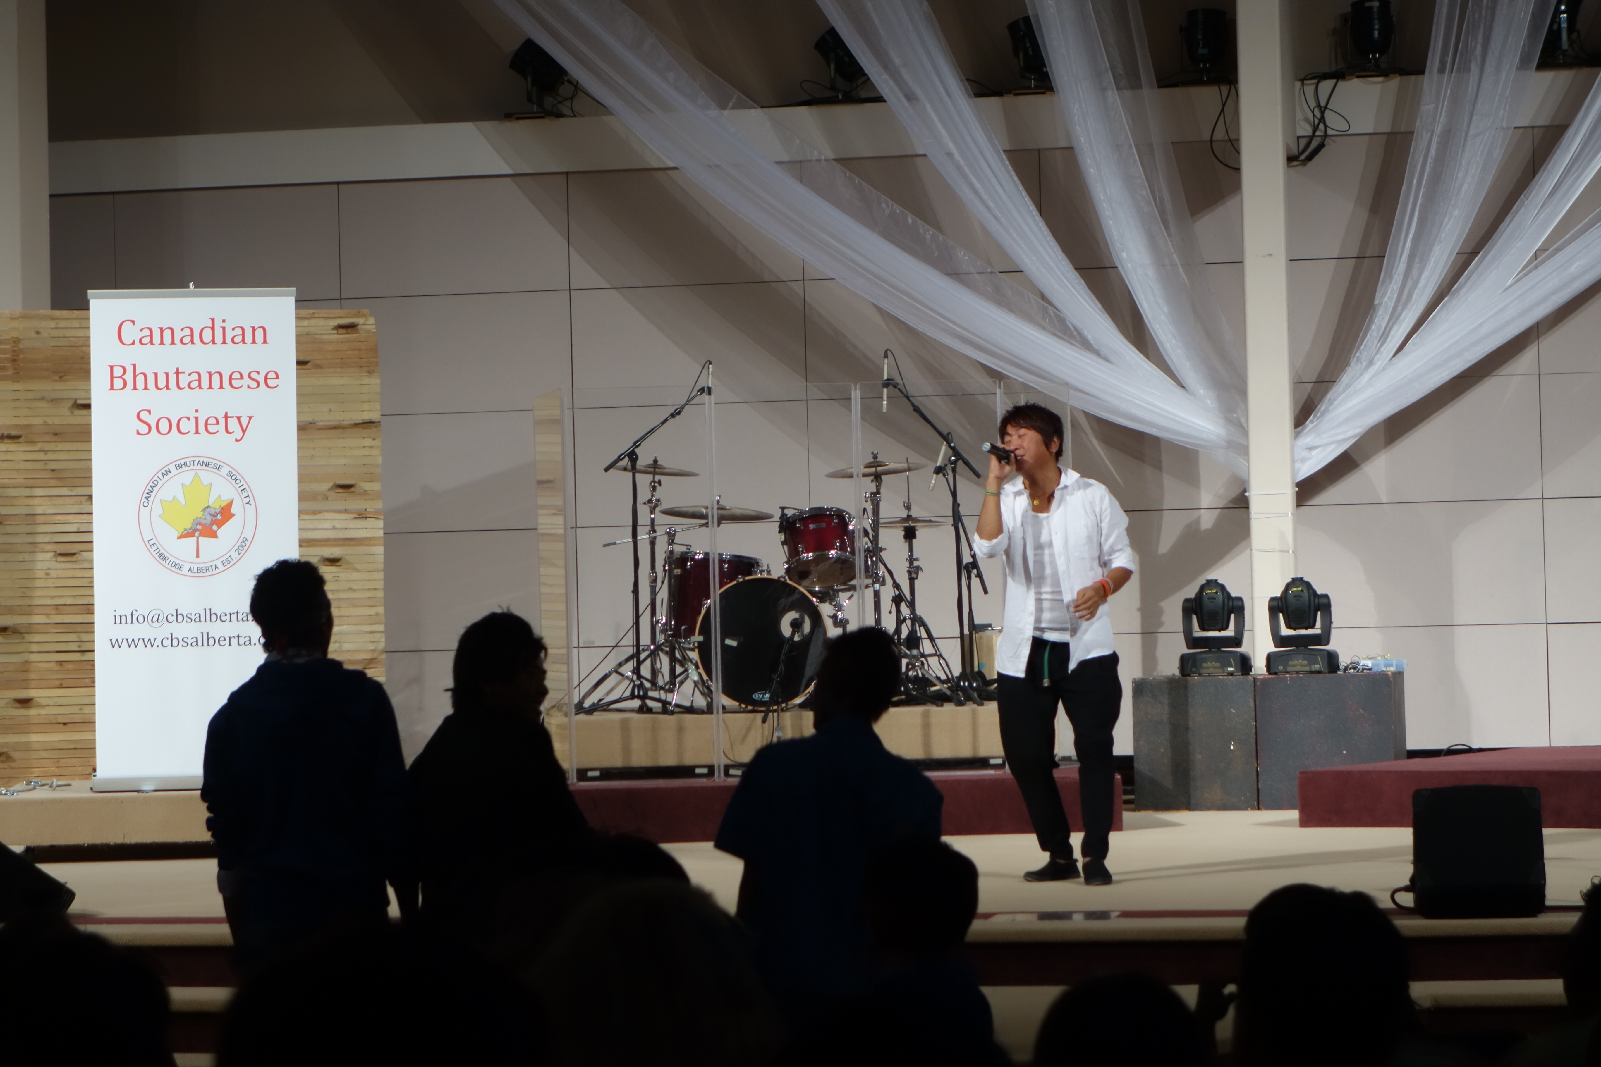
Events:
October 12,2014: Canadian Bhutanese Society Dashain and Tihar Festival Celebration

Slide 19
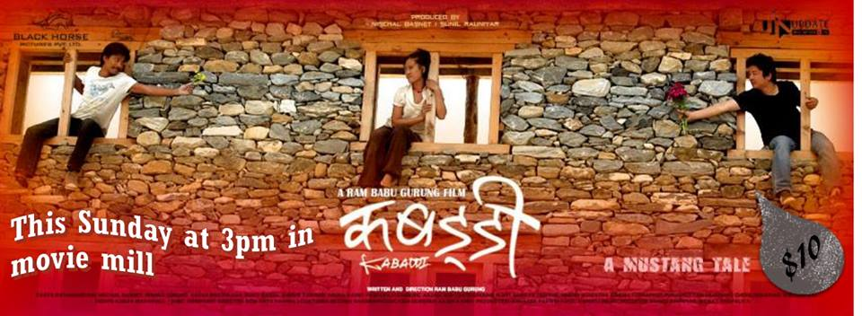
Events:
Movie Shown In Movie Mill
Notes:
Two Photo

Slide 20
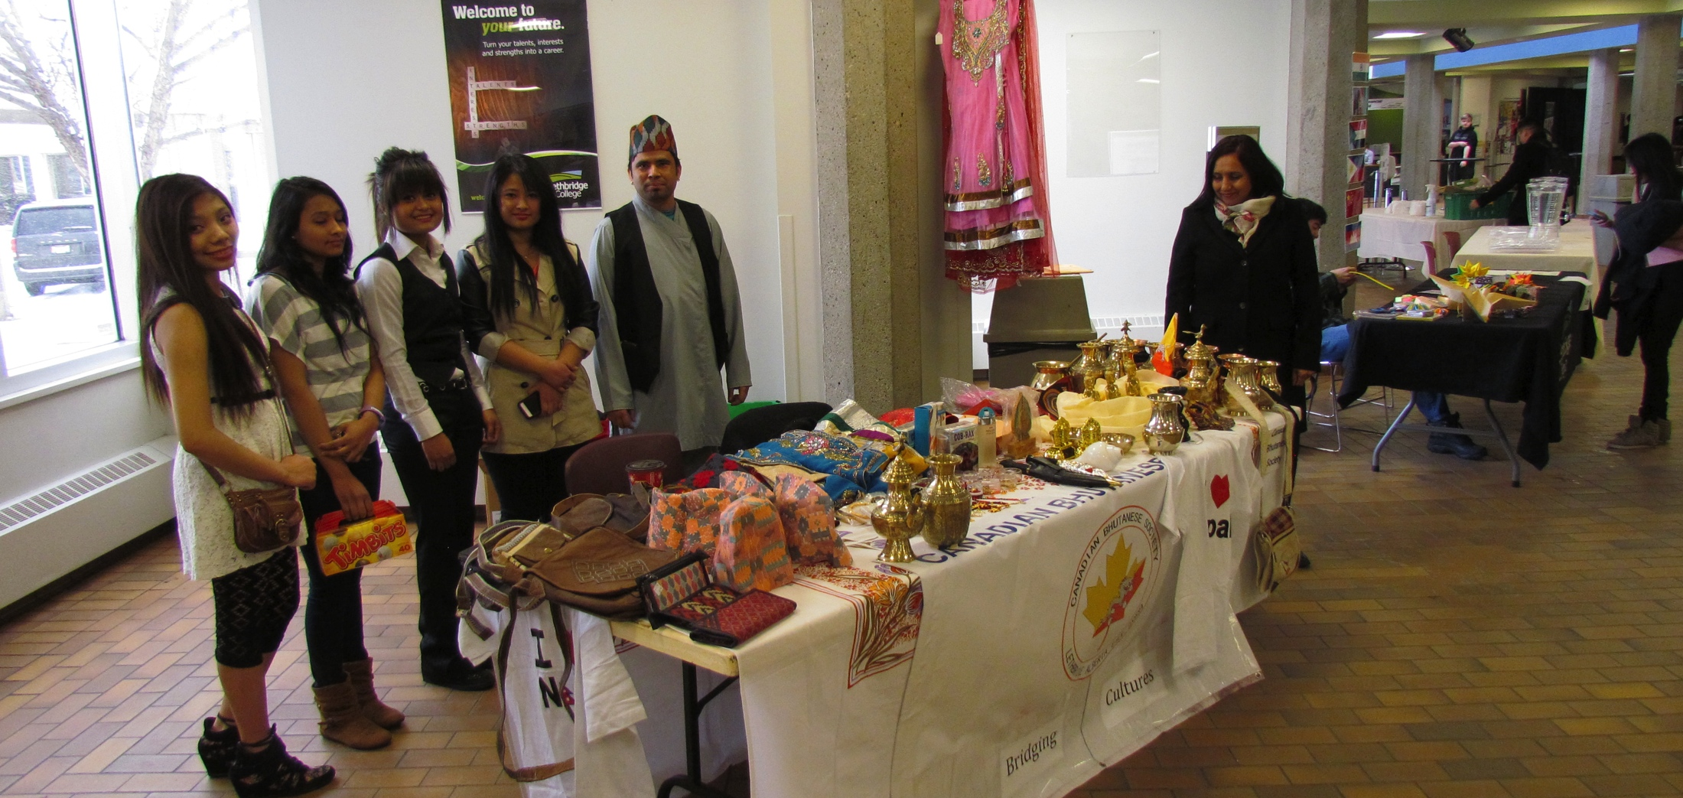
Events:
SAEA Fund Raising Night
BRIDING CULTURES with Lethbridge College

Slide 21
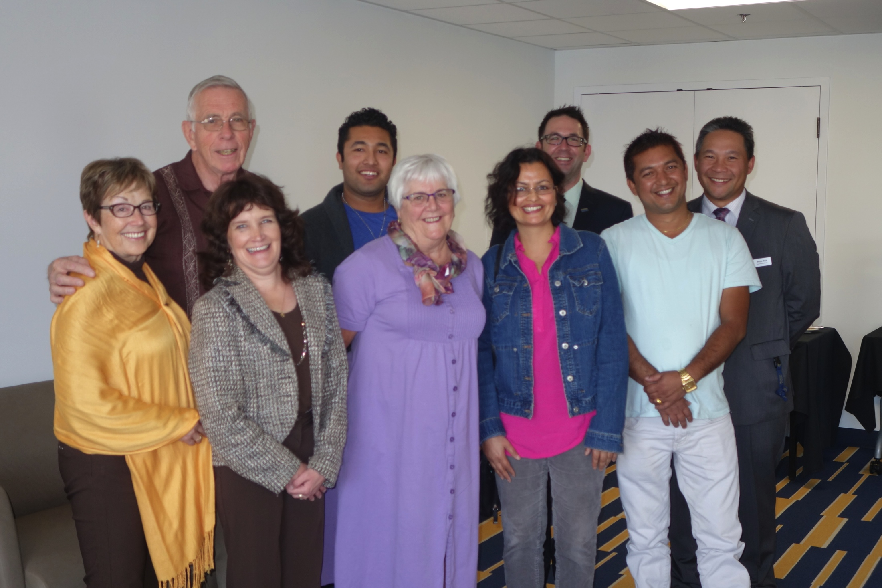
Achievements
Warren Family Scholarship awarded to Canadian Bhutanese Society member Mr. Santosh Timsina, U of L.

Slide 22
Achievements:

Slide 23
Achievements:

Slide 24
Achievements:

Slide 25
Achievements:

Slide 26
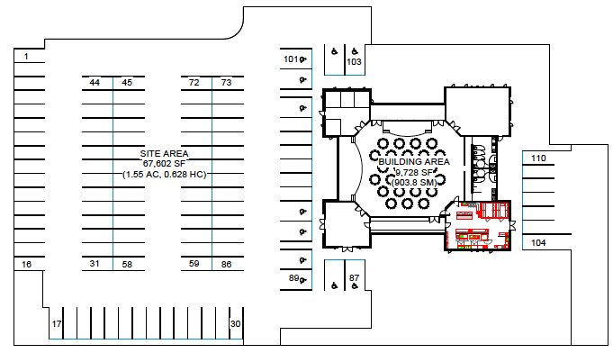
Achievements:

Slide 27
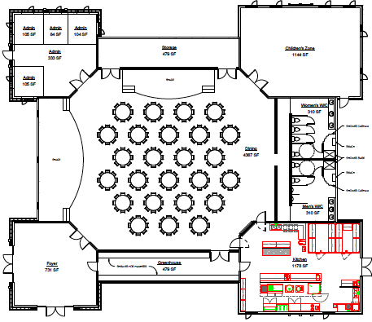
Achievements:

Slide 28
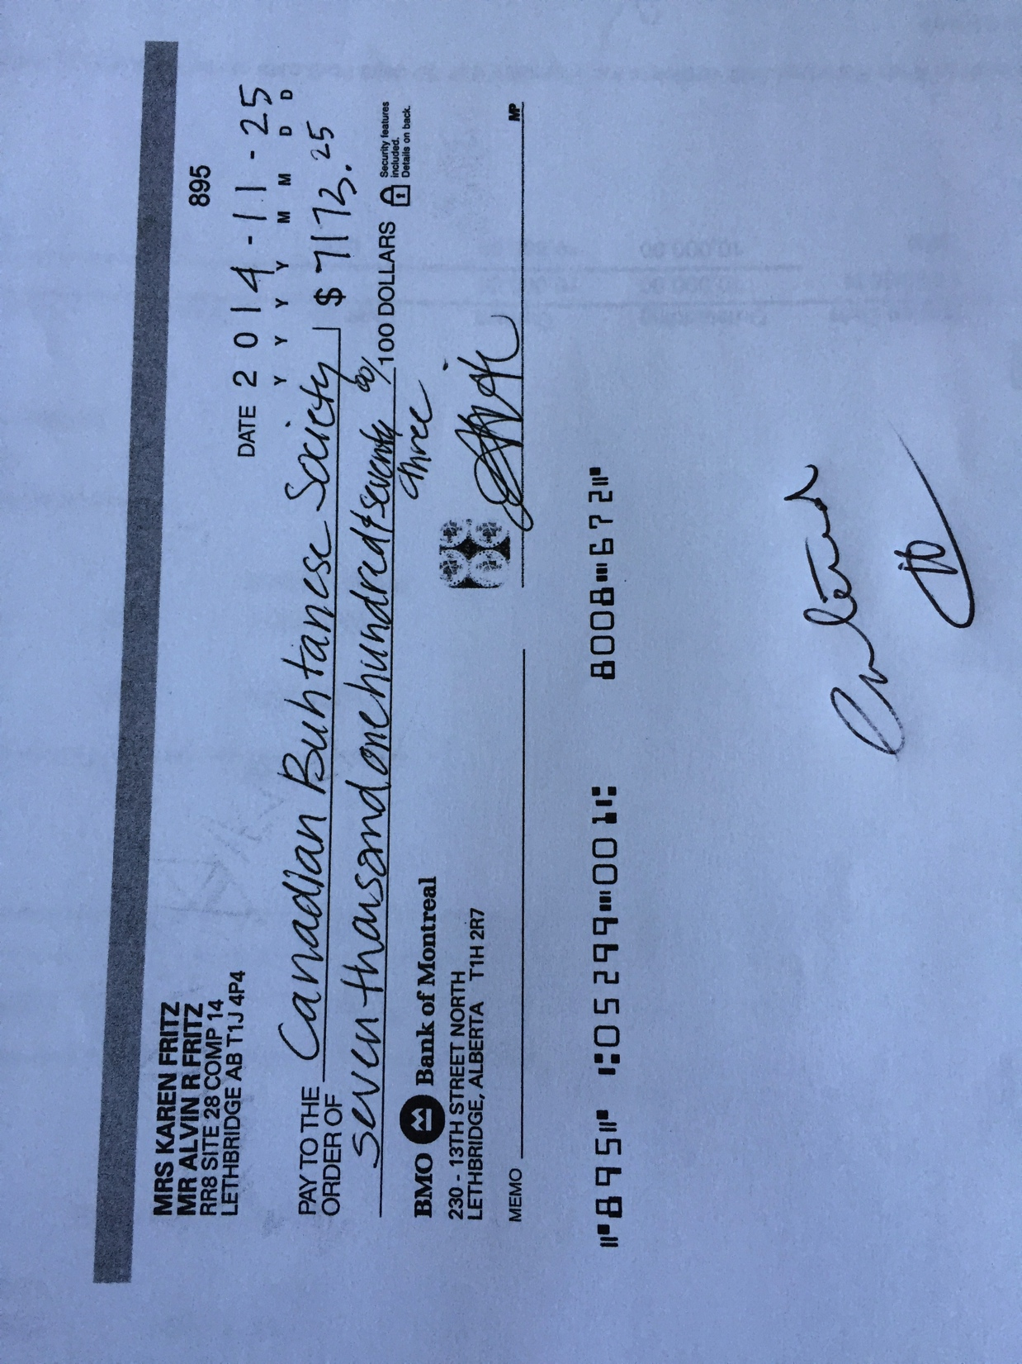
Achievements:
Thanks to Alvin R. Fritz Architect
For their kind donation of 7173.28 towards the designing and rendering of Bhutanese community Hall’s drawing

Slide 29
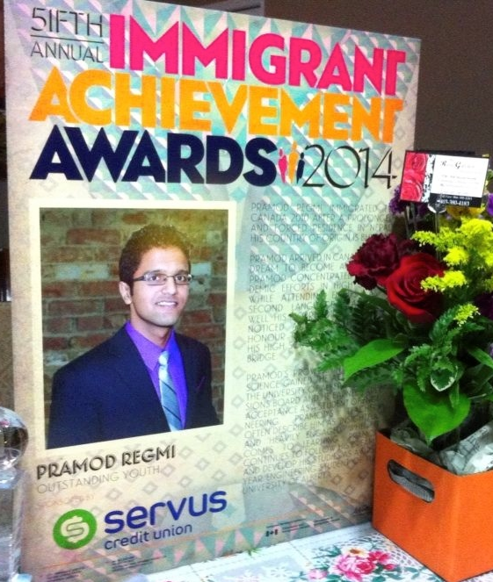
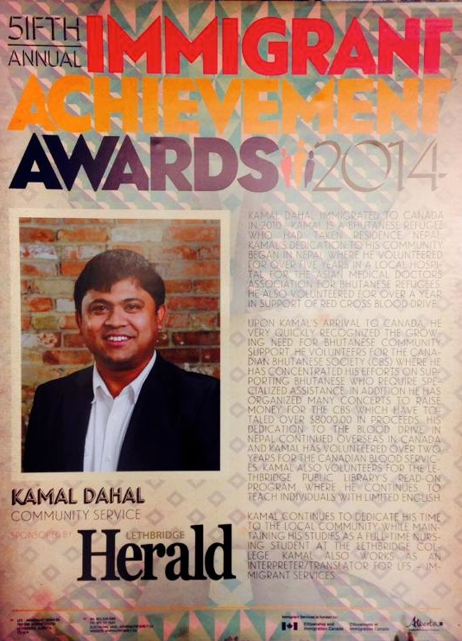
Achievements:

Slide 30
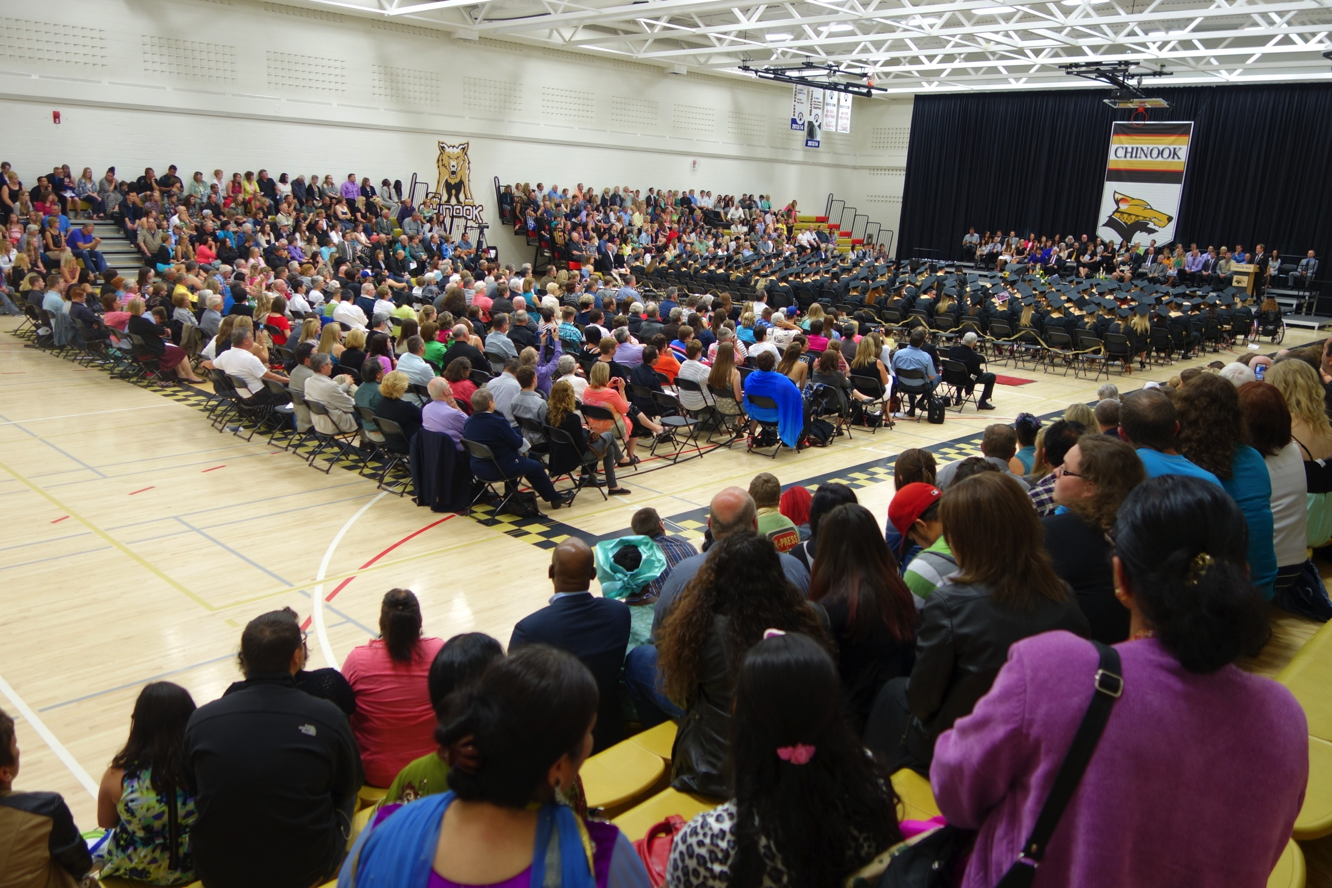
Achievements:
High School Graduation
Promod , Ishwor, Kausila

Slide 31
Achievements:
Canadian Bhutanese Society
applied for Alberta Licensing and
Gaming Commission‘s Volunteer program from Casino Funding
Notes:
Citizen ship 30

Slide 32
Financial Report: 2014
https://ca.qbo.intuit.com/app/accountant

Slide 33
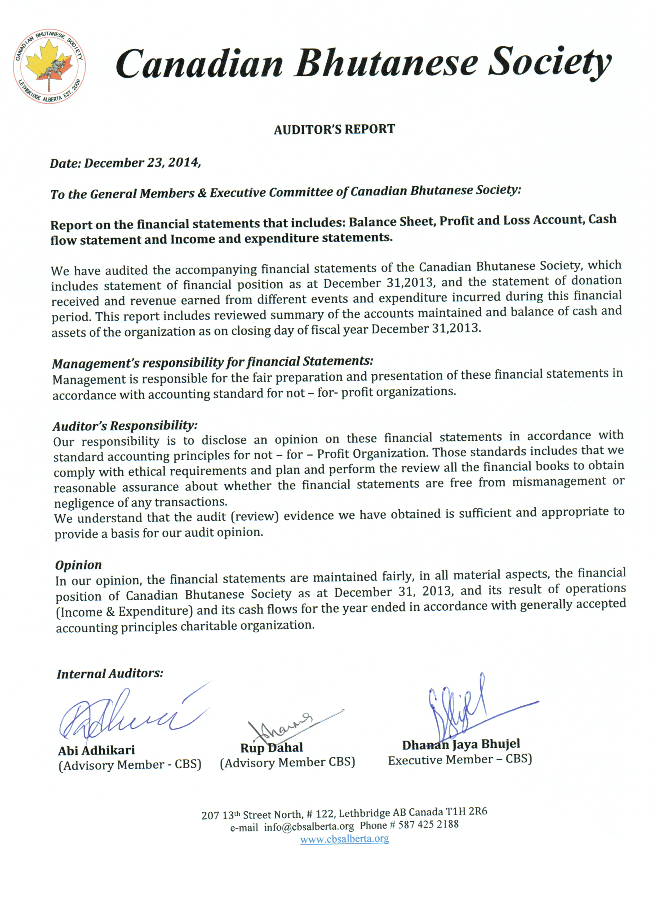

Slide 34
हार्दिक श्रद्धाञ्जली
We are deeply touched by their Loss and sent our sincere
condolence to the family
Chabi Lal Kami
Dhan Rai
Januka Das
Angel Adhikari
Let us take one minute of silence for her soul

Slide 35
On Going and future Activities:
On going meetings with Alberta Culture for CBS’s dream project.
Regular meetings with SAEA
CBS regular internal meetings
Possible Summer Cultural Concert
Annual Cultural Festivals
Citizenship and Driver education Classes
Nepali Music and Education classes

Slide 36
Prepared By Hemlal Timsina
.
Courtesy Of Ramesh Timsina

