Slide 1
Canadian Bhutanese Society
Happy New Year
Annual Report 2013

Slide 2
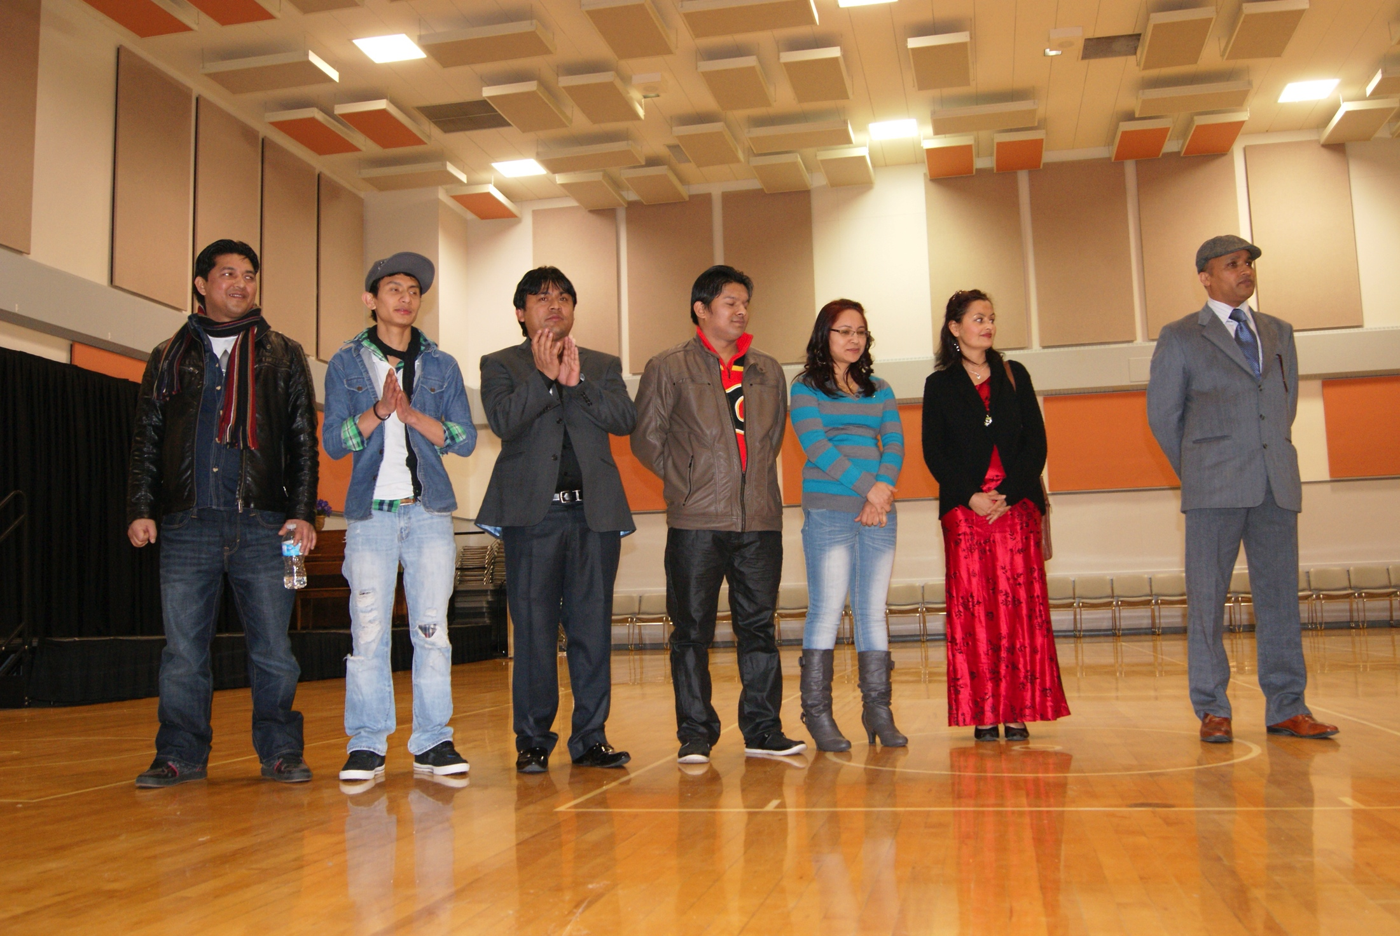
CBS Executive Board Members 2013
President: Mr. Hemlal Timsina
Vice President: Miss. Geeta Rasaily
Secretary: Mr. Dhanan jaya Bhujel
Treasurer: Miss. Indira Sharma
Cultural Coordinater: Mr. Dipak Gurung
Cultural Special Events Coordinator: Mr. Kamal Dahal
Sport and Youth Coordinator: Mr. Chandra Adhakari
हामी तपाइँको निरन्तर सहयोग को लागि सबैलाई धन्यवाद दिन चाहन्छु।

Slide 3
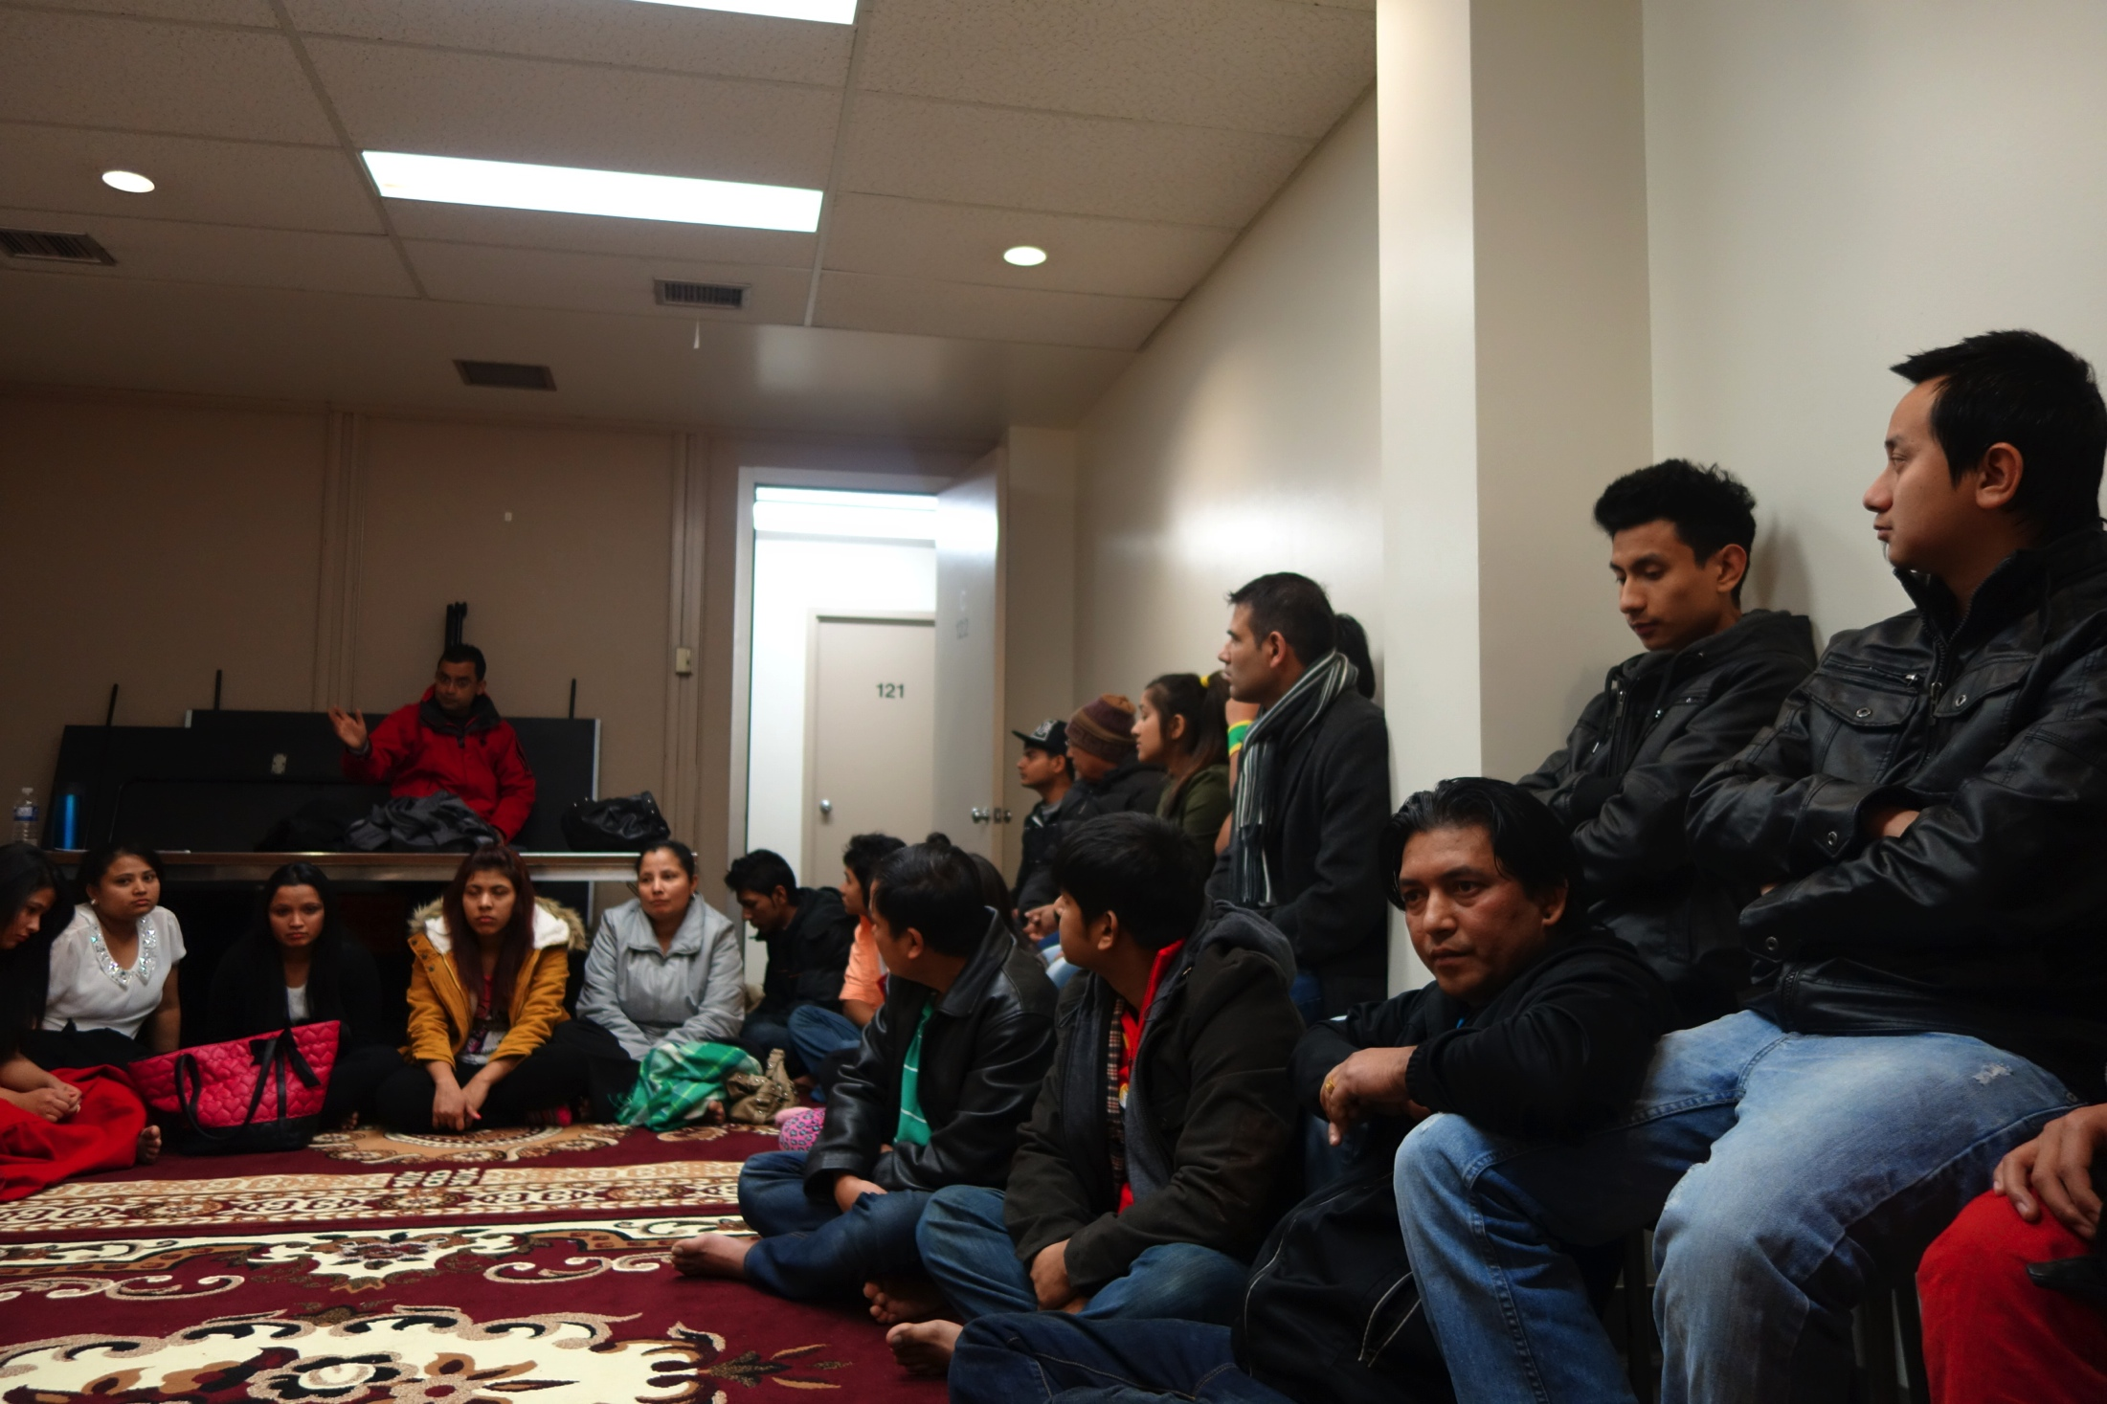
CBS Annual Report January 2013-December 2013
Welcoming the new comers
Meetings
Training and workshop
Events
Achievements
Financial report
On going and future activities
Condolence

Slide 4
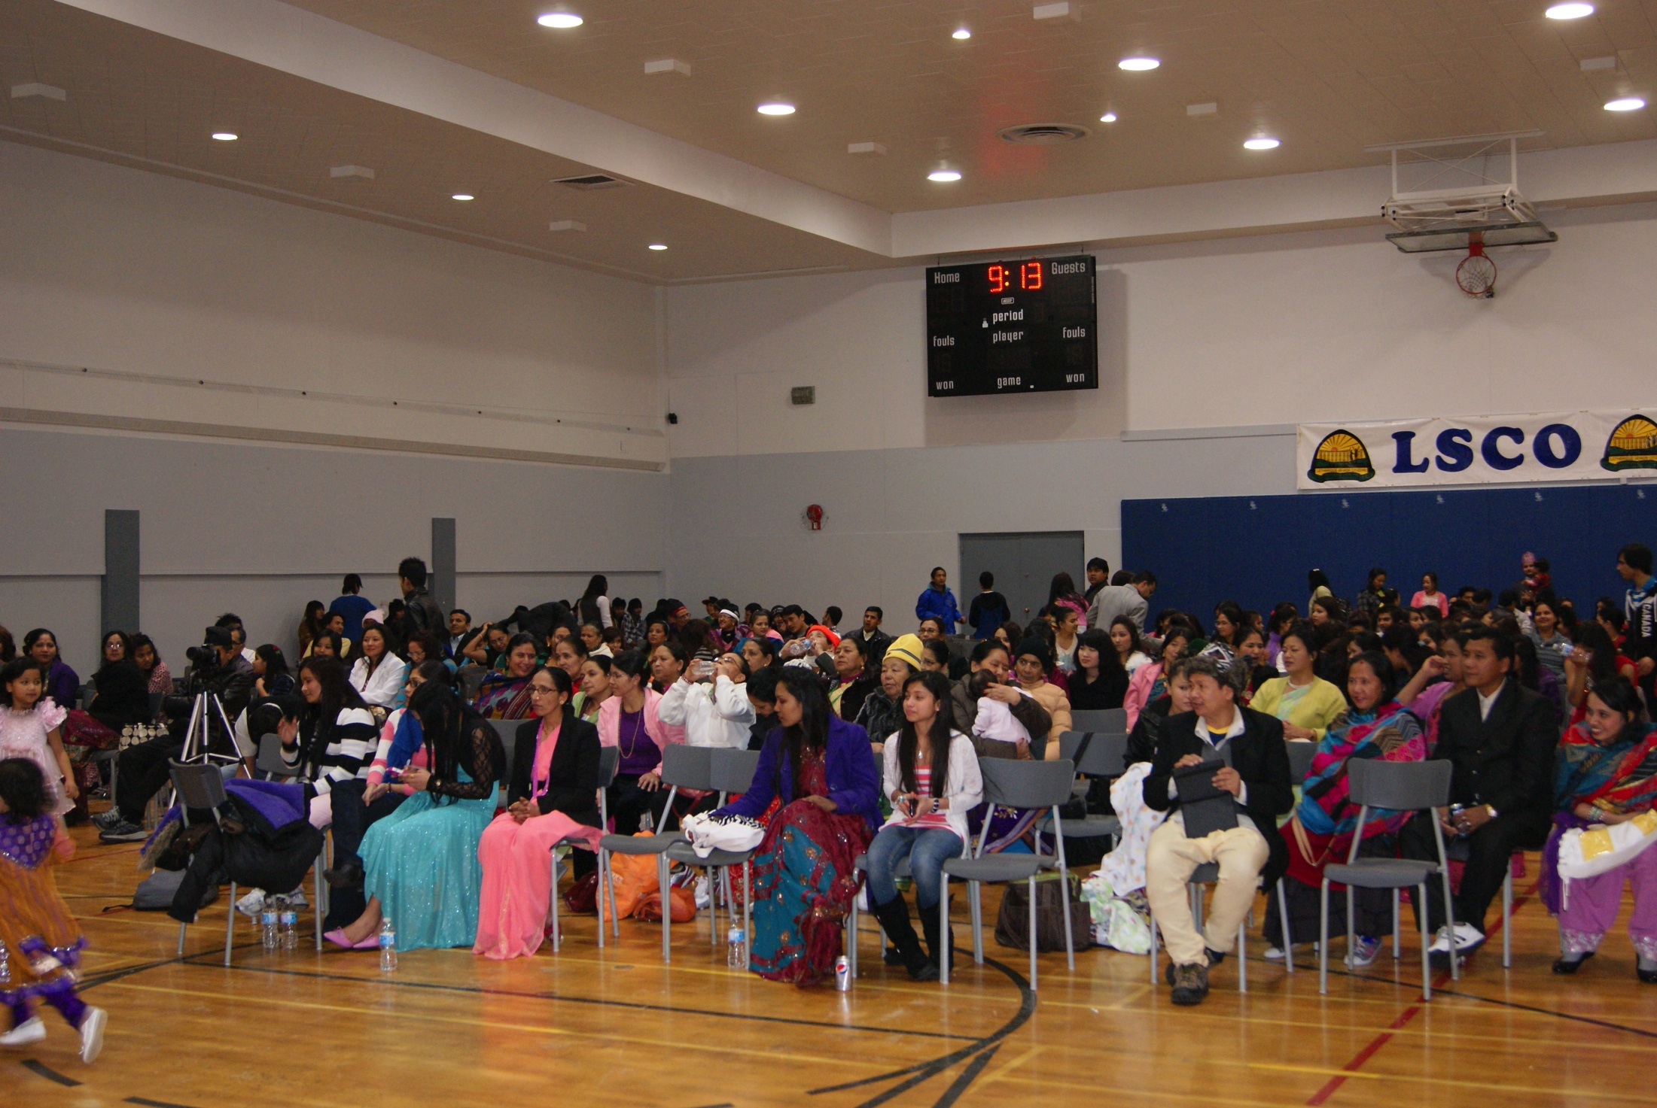
Welcoming the New Comers
This year we have many new faces in Lethbridge. Some are stepping to this world for the first time and some have chosen this place as their future home. Many of us came from Nepal, and some of us moved from various provinces within Canada. Let us welcome them all together with a big applause.
2013 New Arrivals to Lethbridge: 110
Total Population:755

Slide 5
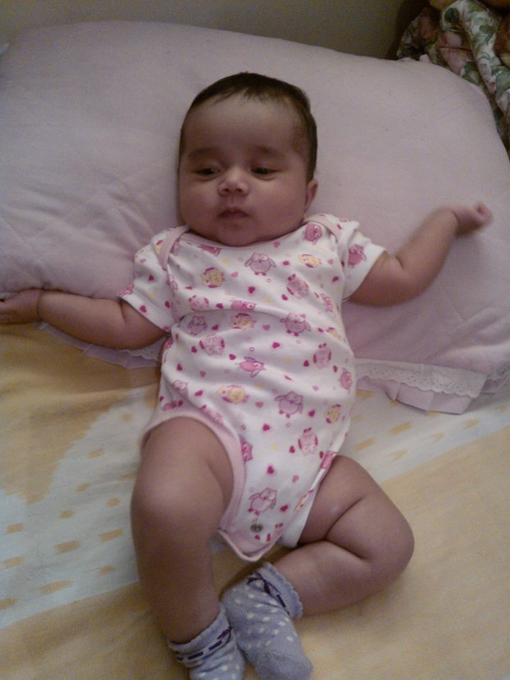
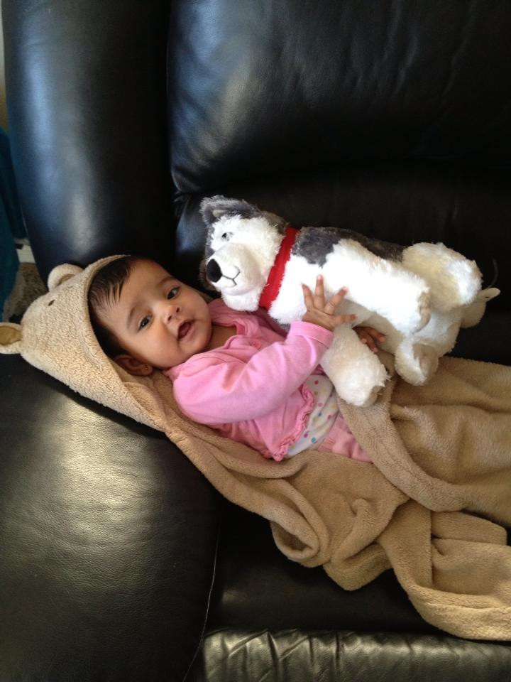
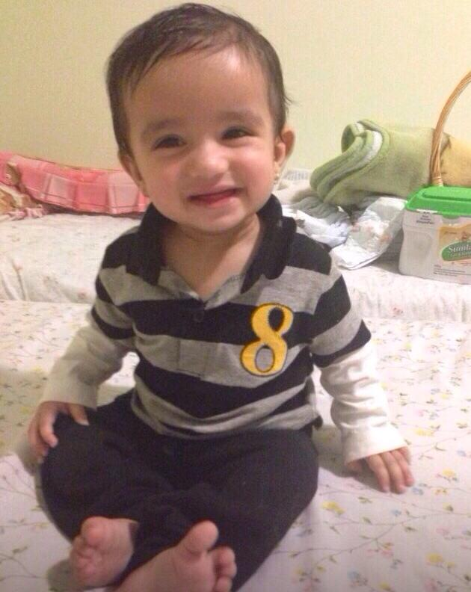
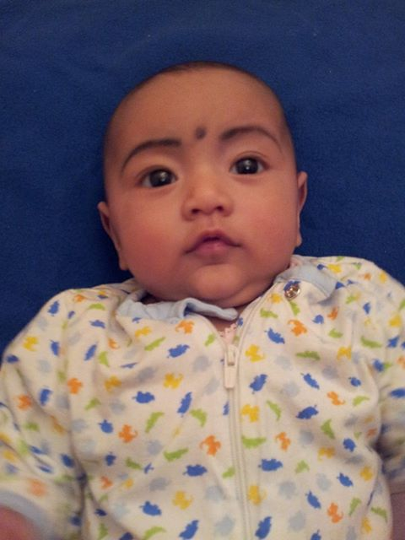
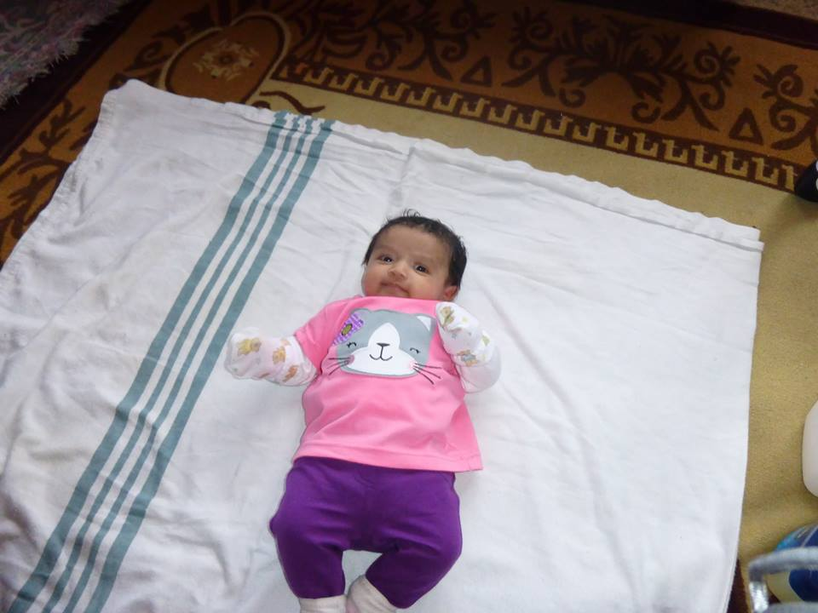
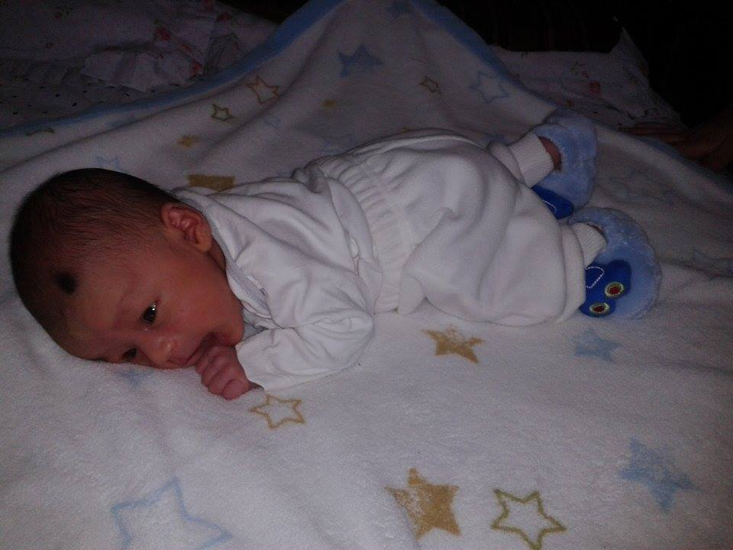
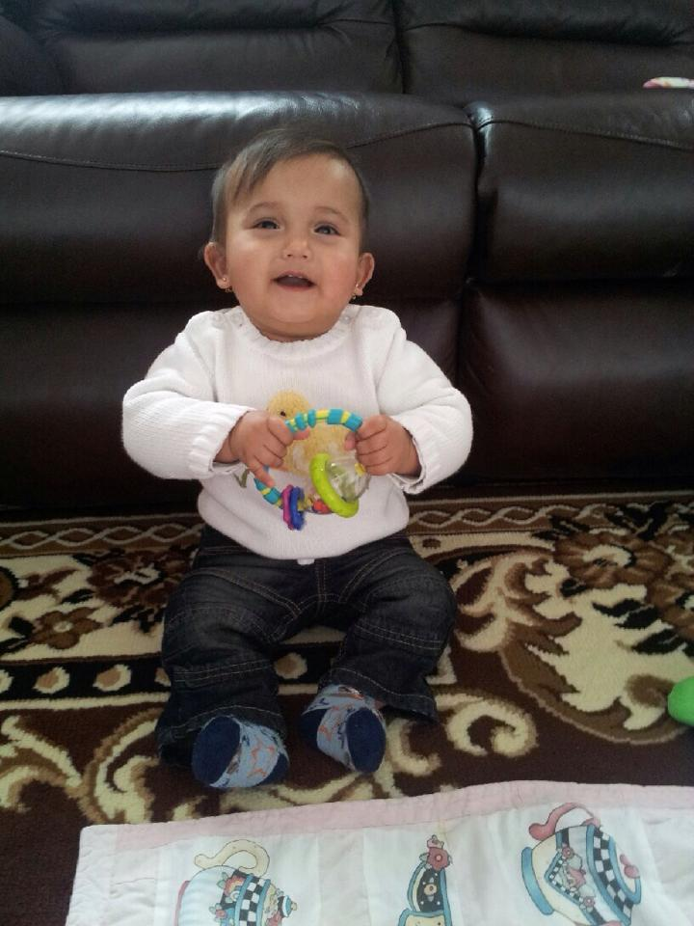
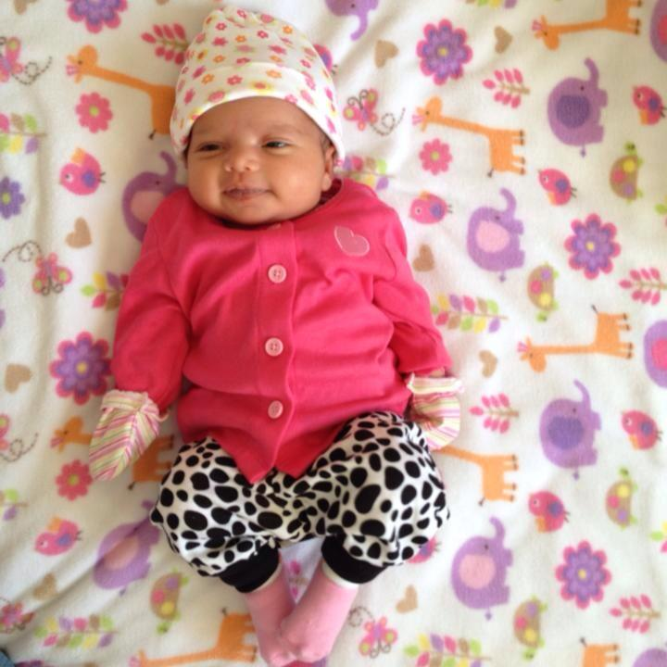
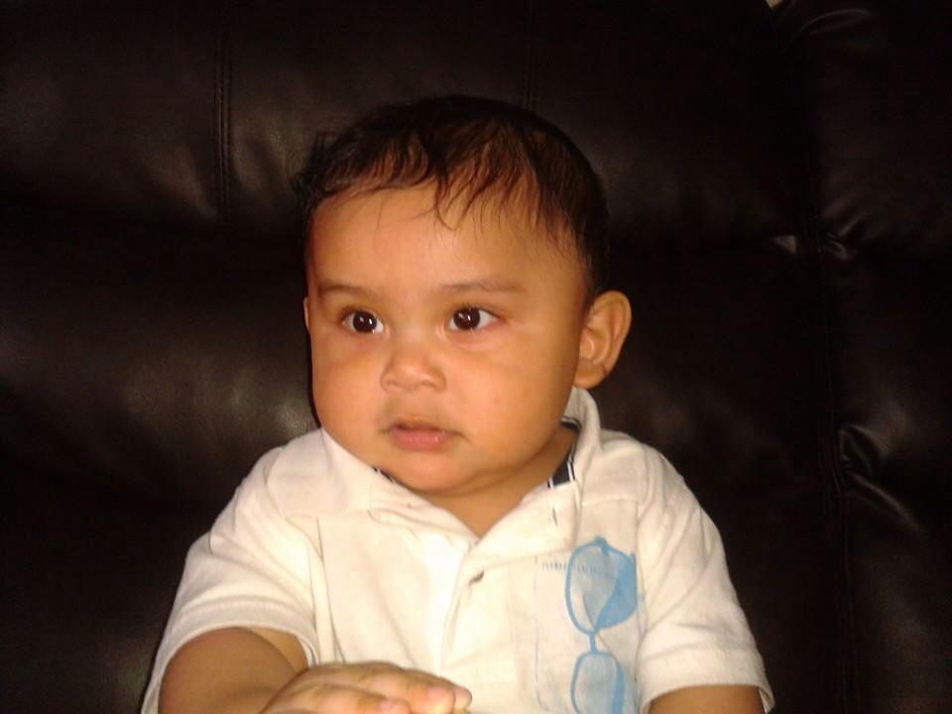
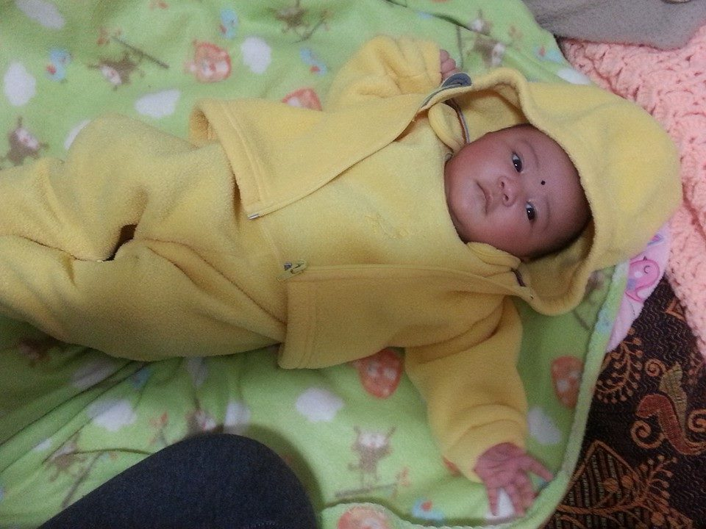
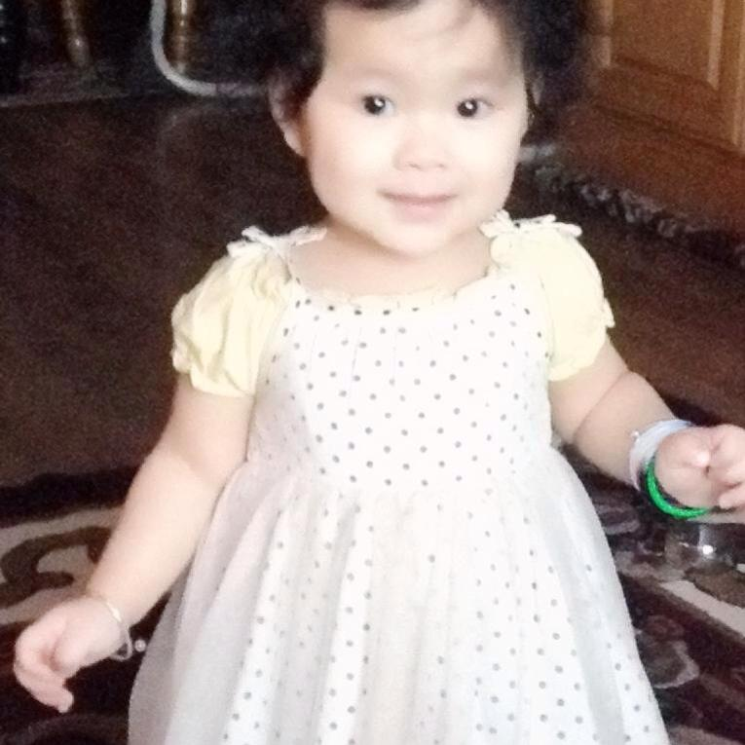
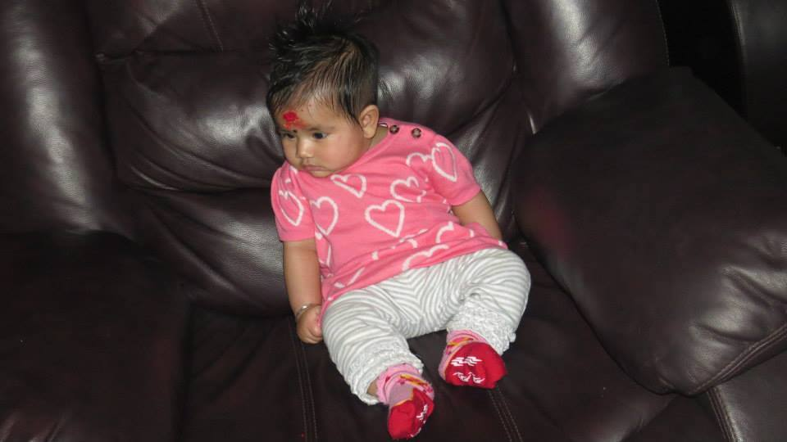
New born babies of this year “future of our Society”
Aayan Sarki
Shikha Gurung
Pratuish
Timsina
Anisa Timsina
Ashika Gurung
Pranisha Sharma
Sarins Dhakal
Sunima Bhujel
Sabeel Lowgon
Aryana Nerula
Evan Bhujel
Aanushka Gurung
Divana Subedi

Slide 6
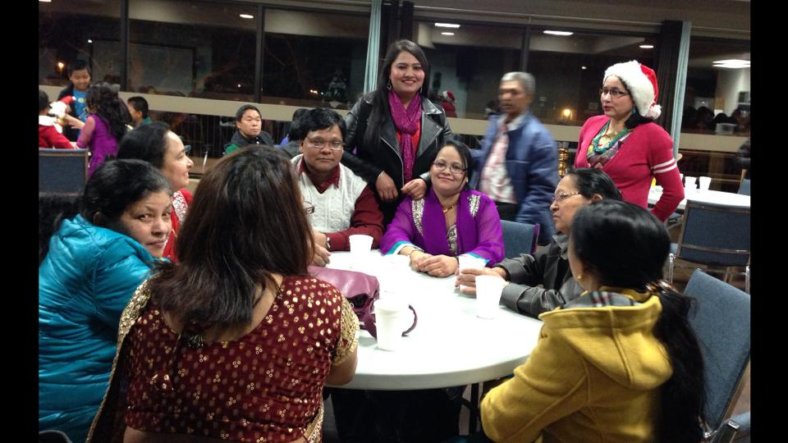
Meetings:
8 CBS Internal Meetings
9 Inter-Agency Meetings with LFS IS, SAEA, LRPS, Library, SALAS
3 General Meetings
2 Seniors Meetings, including one on Nepali New Year Celebration
4 Meetings with Alberta Culture

Slide 7
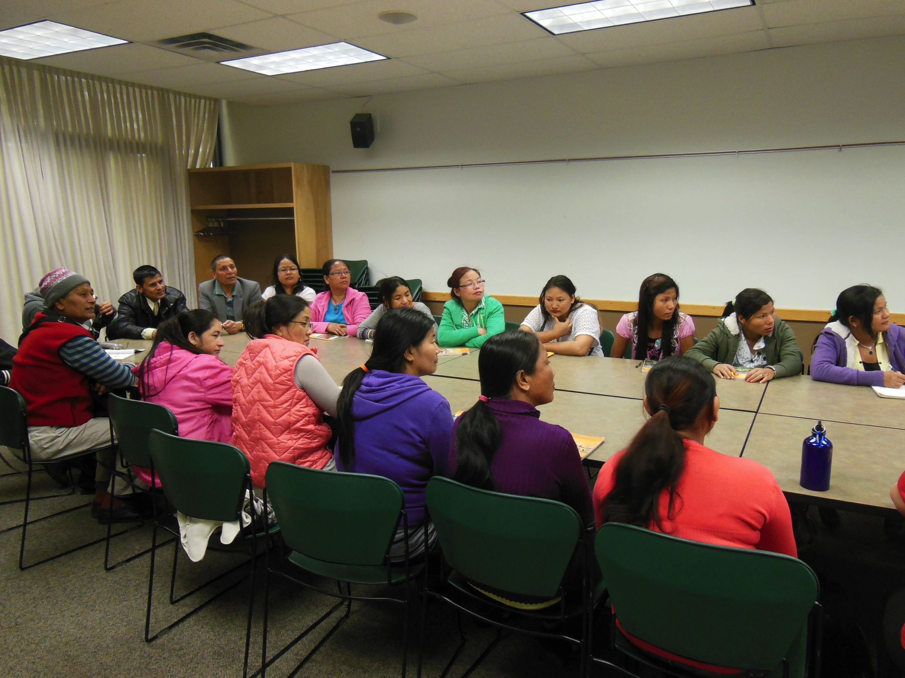
Training and Workshop:
Ten members of the CBS attended one day training organized by Alberta Culture during the month of January 2013. Training was focus on how to function, manage and share responsibility of an organization.

Slide 8
Events:
March 21st : CBS participated in ‘Bridging Cultures’ event organized by Lethbridge College.

Slide 9
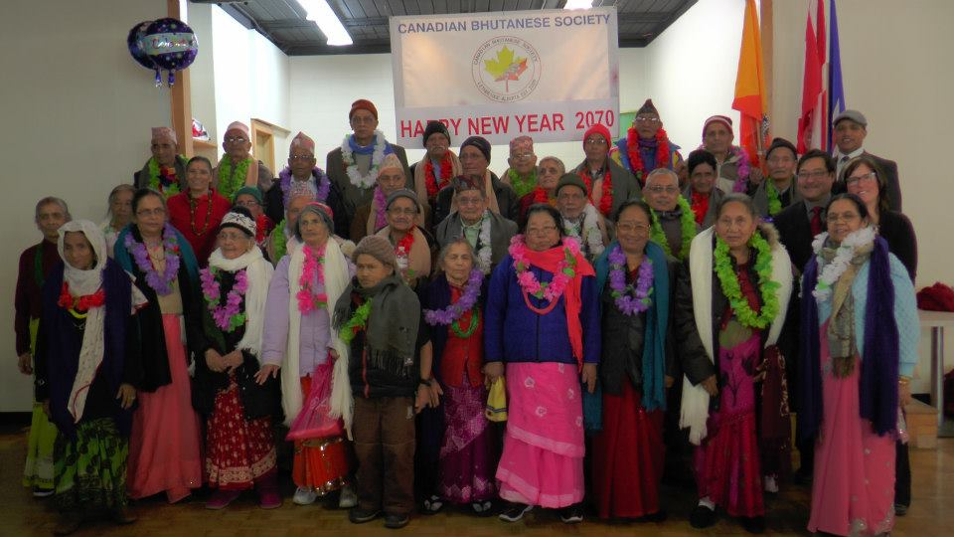
Events:
April 14th : CBS celebrated Nepali New year 2070, where CBS paid respect and honored the seniors members of the communities.

Slide 10
Events:
August 10th : CBS hosted a Nepali Cultural Concert ‘ Raju Lama Night’, which was a very successful event.

Slide 11
Events:
August 30th : CBS hosted culture night event in partnership with SAEA ‘The Taste of Bhutan’.

Slide 12
Events:
September 22nd : CBS participated in ‘Word on the Street’ event organized by Lethbridge Public library.

Slide 13
Events:
October 19th : CBS celebrate ‘Happy Dashain’ where we acknowledged the volunteers with ‘Certificate of Appreciation’ and gifts.

Slide 14
Events:
November 28th : CBS participated in ‘Lethbridge Global Night’ event organized by Lethbridge College and University of Lethbrodge in City Hall.

Slide 15
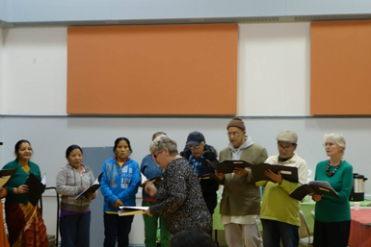
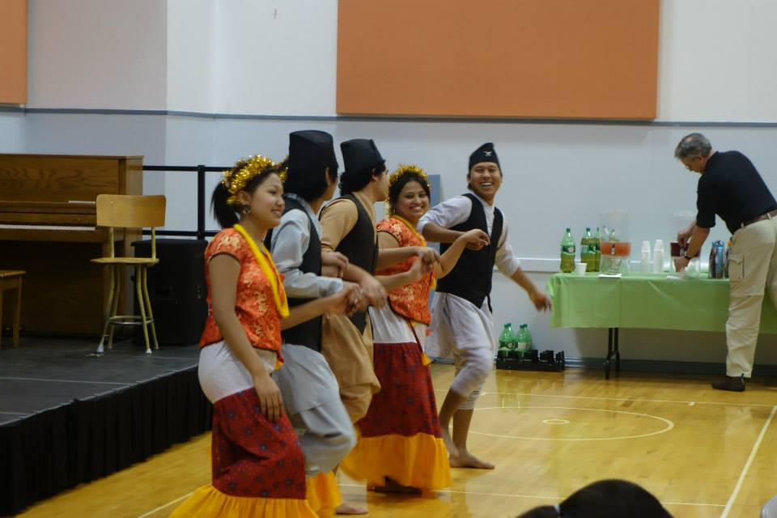
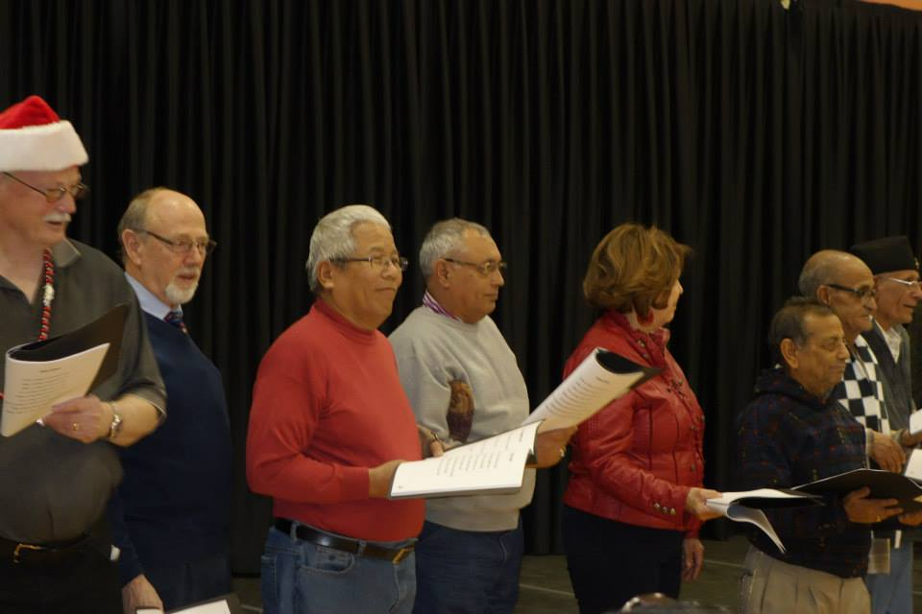
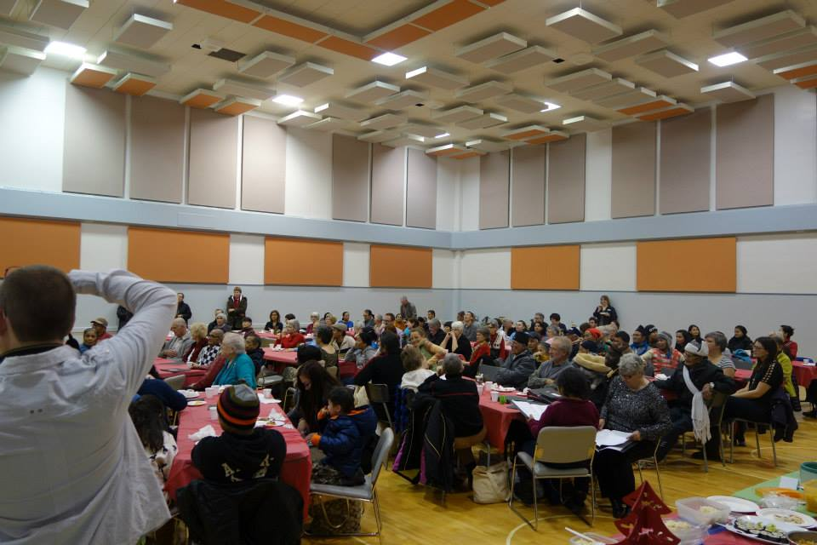
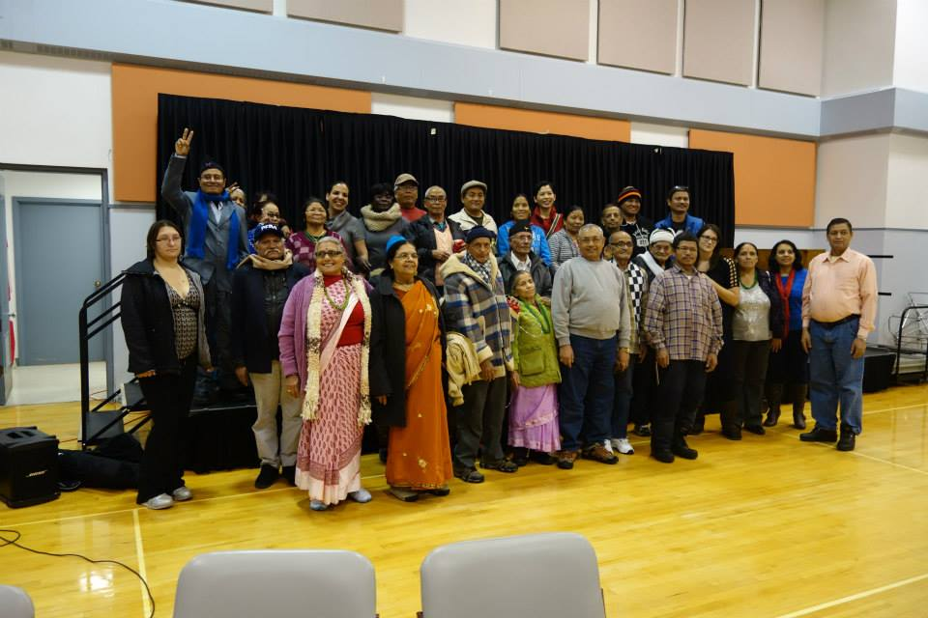
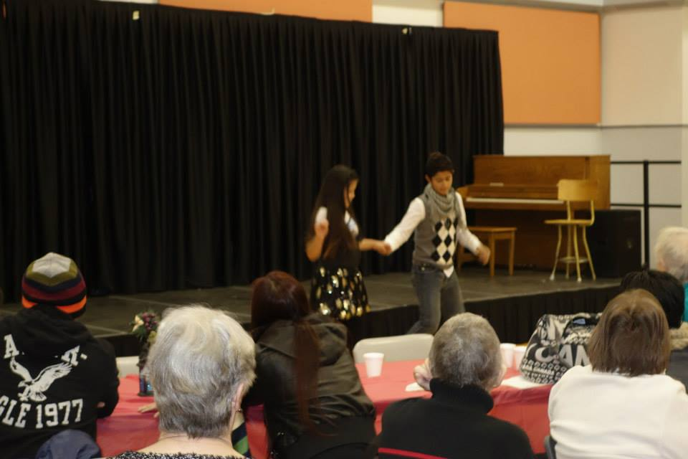
Events:
December 12th : CBS participates in ‘Christmas Party’ event organized by Leathbridge Public Library at Lethbridge Senior Citizens Organization.

Slide 16
Achievements:
Senior’s Program is in progress- Courtesy of Lethbridge Family Services Immigrant Services, City Hall and the Seniors Centres

Slide 17
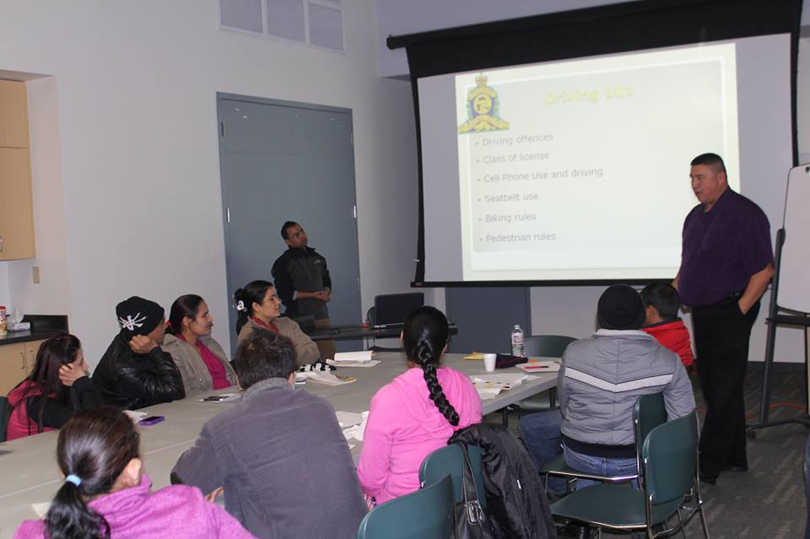
Achievements:
CBS organized Citizenship Classes and continuation of ongoing Driver education classes in partnership with Lethbridge Public Library.
Voluntary Instructors: Abi Adhikari, Laxmi Timsina, Manoj Kr. Dhakal, Suk Man Subba, Purna Bista, Robin Timsina, Kamal Dahal and Purna Adhikari. Thank you and
applause

Slide 18
Achievements:
Establishment of CBS Youth Club is completed. Formal establishment of Youth club is very encouraging and inspiring to many CBS members, as they are the pillars in building a Community.

Slide 19
Achievements:
The Cause Way program from Mortgage Centre, Bev Elliot and The Lawyer Leonard D Fast have donated more than $3500 to CBS. Thank you Susan Maier, Bev and Lawyer Leonard for your support. In addition BCS also availed funds for Dashain festival from the City of Lethbridge.

Slide 20
Achievements:
2013 Immigrant Achievement Award organized by LFS IS, recipients were Santosh Timsina & Purna Adhikari, for outstanding Youth and Community Service respectively. CBS is proud to acknowledge their service and thank them.

Slide 21
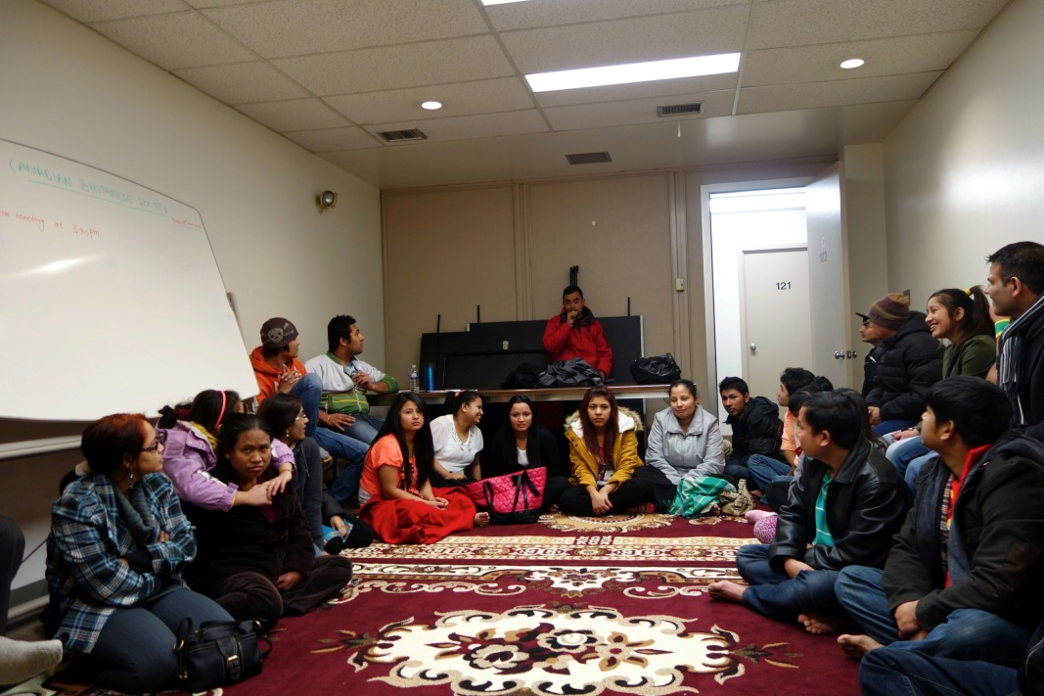
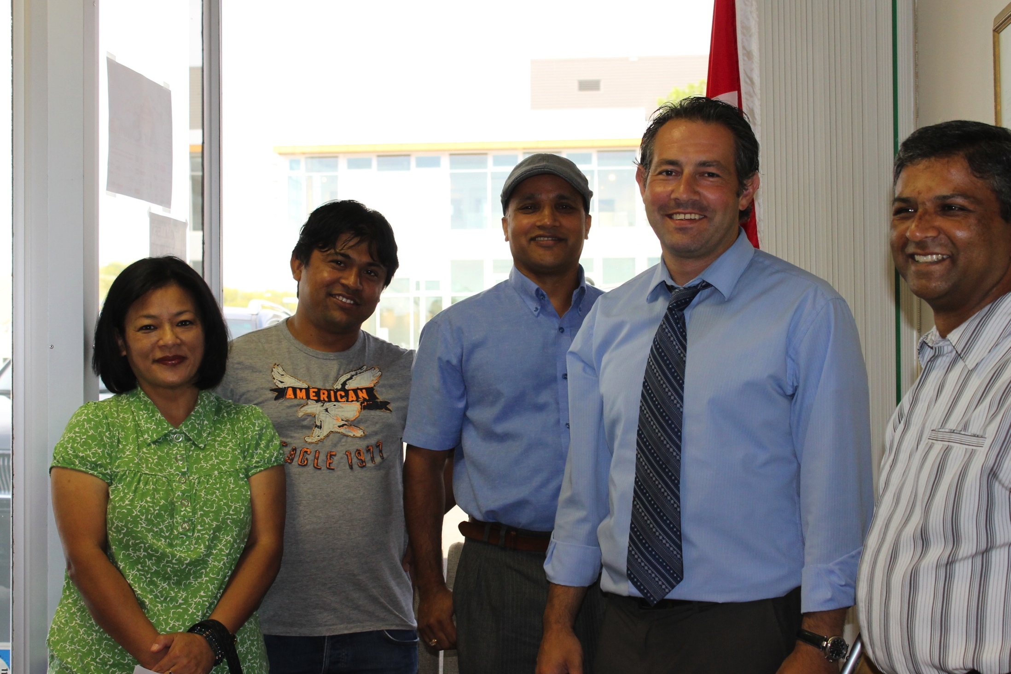
Achievements:
Facility rental with effect from December 1st 2013
CBS Delegation meets MP Jim Hillyer and discussed regarding the new citizenship policy and its implications

Slide 22
Financial Report: 2013

Slide 23
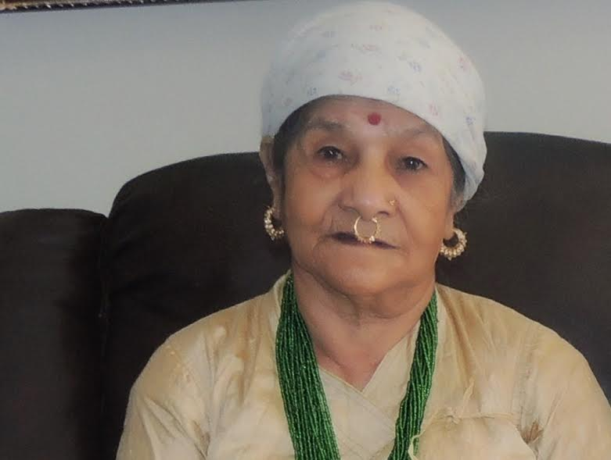
हार्दिक श्रद्धाञ्जली
We are deeply touched by her loss and send our sincere condolences to the family.
Let us take one minute of silence for her soul
मृत: शिव माया सुवेदी
2013, 10th मार्च।

Slide 24
On going and future activities:
On going meetings with Alberta Culture for CBS’s dream project.
Regular meetings with LFS IS in Seniors Advisory Committee
Regular meetings with SAEA
CBS regular internal meetings
Upcoming Western Canada Cultural Games to be held in Lethbridge
Possible Cultural Concert
Annual Cultural Festivals
Citizenship and Driver education Classes

Slide 25
Dhanyabadh
Courtesy of Ambika Dahal and Robin Timsina.

